Slide 1
Topic 4d – Memory Semantics and Codelet Execution Model
CPEG421/621 – Compiler Design

Slide 2
Outline
Introduction
Memory Semantics: Three Key Questions
  Question Q1 and Location Consistency
  Question Q2 and Q3
Memory Semantics and Codelet Execution Model
Summary
Notes:
2

Slide 3
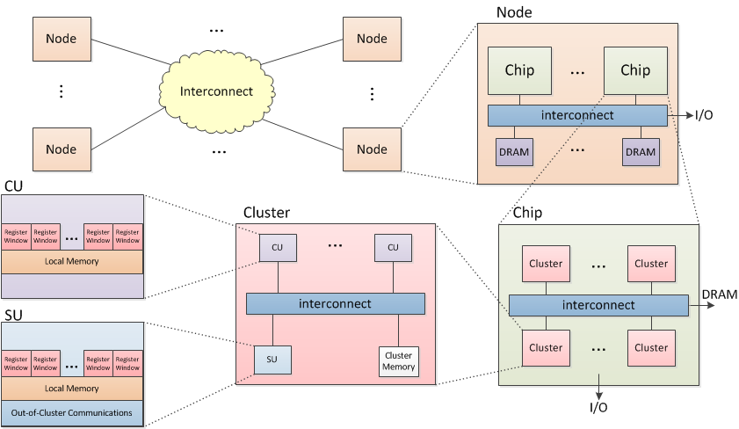
An Abstract Machine Model

Slide 4
Some Philosophical Remarks
Other Parallel Programs
Data-Race-Free
Sequential
Programs
Parallel Programs
1) Make common case efficient (default = no coherence)
2) If you need coherence, SAY SO.

Slide 5
The Java Memory Model
MansonPugAdv05
Weak Consistency
DuboisEtAl86 AdveGha90
Sequential Consistency
Lamport79
2010
2008
2005
Dataflow
Dennis74
2000
1990
1986
C++ Memory Model
BoehmAdv09
1979
1978
1974
Release Consistency
GharachorlooEtAl90
Location Consistency
GaoSarkar00
Causal Acyclic Consistency
ChenEtAl10
Lamport Timestamps Lamport78
Timeline of Memory Models

Slide 6
Sequential Consistency (SC)
[Hardware is sequentially consistent if] the result of any execution is the same as if the operations of all the processors were executed in some sequential order, and the operations of each individual processor appear in this sequence in the order specified by its program.
[Lamport 79]

Slide 7
P1
P2
Pn
S1
S2
Sn
Memory
S = interleave (S1, S2, …Sn)
Memory
The SC Memory Model

Slide 8
“Memory Coherence”
A Basic Assumption of SC-Derived Memory Models
“…All writes to the same location are serialized in some order and are performed in that order with respect to any processor…”
[Gharacharloo Et Al 90]

Slide 9
Open Questions
Is the SC model easier for programmers ?
Is the performance gain due to relaxed SC-derived model worth the complexity ? ([Hill’98])

Slide 10
Outline
Introduction
Memory Semantics: Three Key Questions
  Question Q1 and Location Consistency
  Question Q2 and Q3
Memory Semantics and Codelet Execution Model
Summary
Notes:
10

Slide 11
Three Key Question on Memory Models
Q1: What happens when two (or more) concurrent load/store operations happen (arrives) at the same memory location?
Answers ?

Slide 12
Another Two Key Questions
Assuming two memory operations with the same destination memory location address X (i.e. LOAD X or STORE X) are issued through the same processing core.
Should a memory model allows them to become out-of-order along the way ?

Slide 13
Outline
Introduction
Memory Semantics: Three Key Questions
  Question Q1 and Location Consistency
  Question Q2 and Q3
Memory Semantics and Codelet Execution Model
Summary
Notes:
13

Slide 14
Question Q1 on Memory Models
Q1: What happens when two (or more) concurrent load/store operations happen (arrives) at the same memory location?
Answers ?
  Dataflow models (e.g. I-structure/M-Structure) ?
  Sequential consistency (SC) ?
  Release Consistency (RC) model ?
  Java JMM ?
  C++ thread model ?
  Location Consistency (LC) ?
  Others ?

Slide 15
Sequential Consistency
Ref 1
Location Consistency
GaoSarker00
The Java Memory Model
Ref 4
Release Consistency
Ref 2
Causal Acyclic Consistency
Ref 3
C++ Memory Model
Ref 5
Strongest Memory Model
Weakest Memory Model
Coherence
Causality
Weakness of Memory Models
Memory models that may cause causal cycles
Memory models that may violate coherence

Slide 16
Question: Can we Remove the “Memory Coherence” barriers?
Answer: Yes!

Slide 17
By intuition, The answer is
“Yes”!
That is:
If you need an order to be “enforced” between two memory ops by hardware – Say it!
Otherwise, hardware should not have an obligation to “serialize” the memory operation!

Slide 18
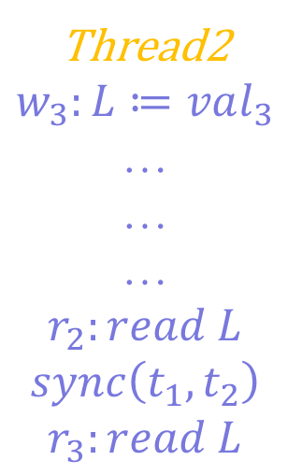

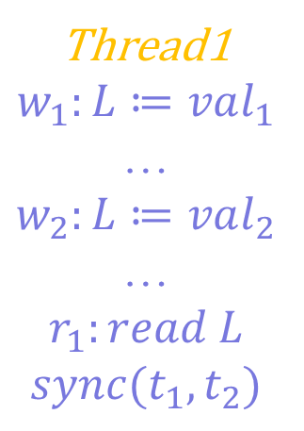
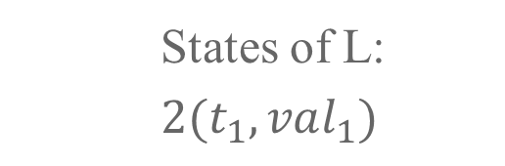



An Example
Thread1
$$w_{1}:L≔val_{1}$$
…
$$w_{2}:L≔val_{2}$$
…
$$r_{1}:read L$$
$$sync(t_{1}, t_{2})$$
Thread2
$$w_{3}:L≔val_{3}$$
…
…
…
$$r_{2}:read L$$
$$sync\left(t_{1}, t_{2}\right)$$
$$r_{3}:read L$$
States of L:
$2(t_{1},val_{1})$
(a “growing” pomset!)
$w(t_{2},val_{3})$
$w(t_{1},val_{2})$
$$sync(t_{1},t_{2})$$
$$r(t_{2})$$

Slide 19
Outline
Introduction
Memory Semantics: Three Key Questions
  Question Q1 and Location Consistency
  Question Q2 and Q3
Memory Semantics and Codelet Execution Model
Summary
Notes:
19

Slide 20
Another Two Key Questions Related to Memory Models
Assuming two memory operations with the same destination memory location address X (i.e. LOAD X or STORE X) are issued through the same processing core.
  Notes: We assume that the two memory operations are issued in their program order. Both of the two memory operations access memory location address X.
  Q2: Should the hardware (architecture) permit > 1 alternative paths of routing of the memory operations (transactions) along the way?
  Q3: If the answer of Q2 is true (I assume it is) - then it is well possible that the two operations may arrive at its destination out-of-order?

Slide 21
Your Answers to the Questions ?
  Q1: Should the hardware (architecture) permit > 1 alternative paths of routing of the memory operations (transactions) along the way?
  Q2: If the answer of Q1 is true (I assume it is) - then it is well possible that the two operations may arrive at its destination out-of-order?
No. | Answer to Q1 | Answer to Q2 | Which one ?
1 | Yes | Yes
2 | Yes | No
3 | No | Yes
4 | No | No

Slide 22
Possible Answers to the Questions
  Q1: Should the hardware (architecture) permit > 1 alternative paths of routing of the memory operations (transactions) along the way?
  Q2: If the answer of Q1 is true (I assume it is) - then it is well possible that the two operations may arrive at its destination out-of-order?
No. | Answer to Q1 | Answer to Q2 | Who answered
1 | Yes | Yes | GG, MM
2 | Yes | No | BS
3 | No | Yes | MS
4 | No | No | DD,SS

Slide 23
Outline
Introduction
Memory Semantics: Three Key Questions
  Question Q1 and Location Consistency
  Question Q2 and Q3
Memory Semantics and Codelet Execution Model
Summary
Notes:
23

Slide 24
Memory Model of Codelets
The shared memory model is based on LC (Location Consistency, Gao and Sarkar 2000) and it variants/extensions.
There is no global coherence requirement due to LC
Our answer to the 3 questions (Q0, Q1, Q2) will led the extensions to LC: Work In Progress!

Slide 25
Outline
Introduction
Memory Semantics: Three Key Questions
  Question Q1 and Location Consistency
  Question Q2 and Q3
Memory Semantics and Codelet Execution Model
Summary
Notes:
25

Slide 26
Summary
The memory model of a PXM will help define its scalability
Classical PXMs (SC,…) do NOT scale well on future manycore architectures
We want to get rid of coherence, without throwing causality away.
Relaxed memory models, such as Location Consistency, can help design bigger, more scalable manycore systems.
Programming languages need to be aware of parallelism
  Need to know about the underlying memory model
  Even traditionally sequential languages (C,C++) are starting to provide a crude memory model to handle concurrency and parallelism
  Other languages, designed to be “concurrentcy-aware” (Java, X10, Chapel, …) provide a more refined memory model – but maybe still too relaxed

Slide 27
Topic 4e – Using the Codelet Model for Exascale Computations

Slide 28
Introduction: Exploiting Parallelism in Many-Core Architectures
Many-core chips are finally here
Current control-flow based frameworks (MPI, OpenMP) incur too much overhead for exascale computing (coarse-grain parallelism)
To efficiently exploit parallelism, fine-grain approaches should be preferred
We propose a Codelet Program Execution Model, based on dataflow theory

Slide 29
An Abstract Machine Model

Slide 30
The Codelet Model
Goals: to effectively represent data and computing resource sharing through a hybrid dataflow approach, using two levels of parallelism
Definition: a codelet is a sequence of machine instructions which act as an atomically-scheduled unit of computation.
fib(n) {
Int x,y;
If (n<2) {
return n;
} else {
x = fib(n-1);
y = fib(n-2);
return x+y;
}
}

Slide 31
The Codelet Graph Model (CDG)
Input
Threaded Procedure
A CDG is well-behaved if, when input tokens are present on all input arcs, it consumes all of its tokens and produces one token on each of its output arcs
Well-behaved CDGs ensure determinate results: for a given set of input tokens corresponds a unique set of output tokens
Codelet
Dependencies
inside a TP
Dependencies
outside a TP
Output

Slide 32
Achieving Exascale Performance
Loop parallelism and Codelet Pipelining: SWP applied to multi/many cores with SSP
Sync-Back Continuations (SBC):
  Evolution of “futures” and “continuations”
  Long-latency operations
  SBCs are asynchronous.
Meeting Locality Requirements
  Codelets inputs are supposed to be locally available.
  A codelet can perform a SBC to retrieve the missing data.
  Percolation can bring code and/or data preemptively to the codelet.

Slide 33
Smart Adaptation in an Exascale CXM: Power, Energy, and Resiliency
Power Management & Energy Efficiency
  Percolation: moving code and/or data efficiently where needed.
  Self-Aware Power Management: the system decides of scheduling and power policies according to goals and dynamic events
Achieving Resiliency on 10⁵ – 10⁶ cores
  Duplicating computation on various parts of the system
  Actively looking for badly-behaving cores
  Check-pointing (easily with CDGs)

Slide 34
Conclusion
Codelets are fine-grain, atomically scheduled sequences of code, grouped into codelet graphs.
The use of sync-back continuations and parallel loop SWP will enable codelets to make as many cores busy as possible
Percolation can improve both data and code locality, as well as energy efficiency
The codelet PXM bets on self-awareness to ensure reliability
A runtime system inspired by codelets already exists (SWARM, by ETI).
We are extending LLVM to be codelet-aware.

