Slide 1
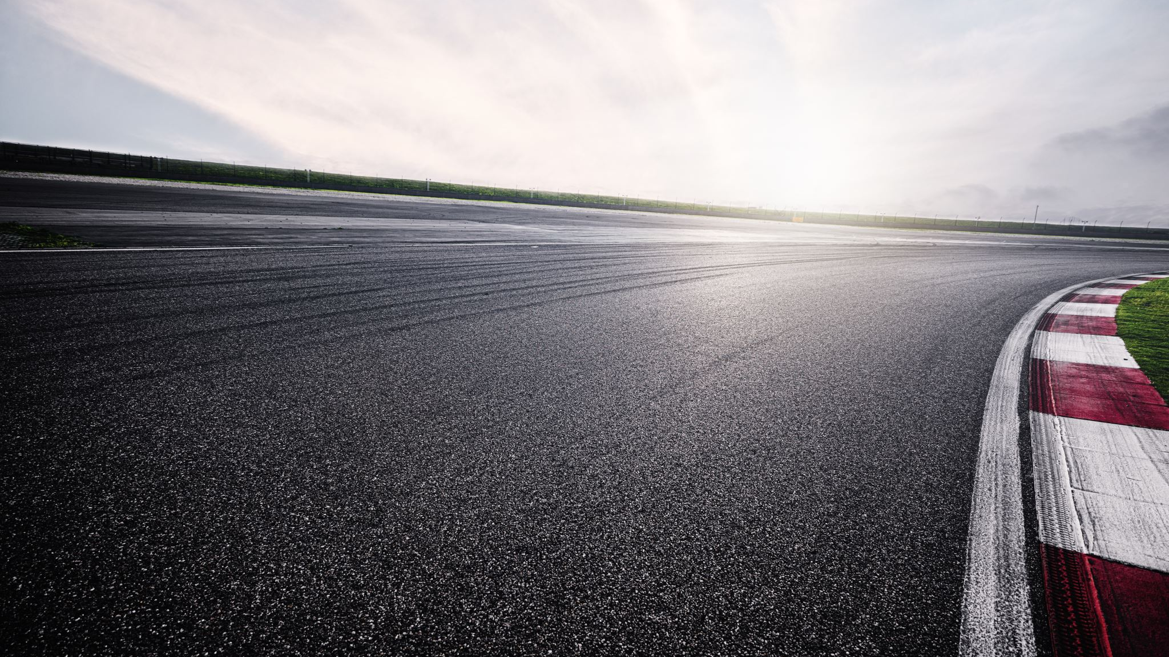
IPDRM 2019
Third Annual Workshop on Emerging Parallel and Distributed Runtime Systems and Middleware

Slide 2
PROCEEDINGS ACCESS
http://bit.ly/ipdrm2019

Slide 3
PANEL
End-to-End Co-Design - Emerging Parallel and Distributed Runtime Systems and Middleware for Extreme-Scale Systems

Slide 4
Emerging trend of extreme-scale system design are rapidly increasing in capacity, scalability and and complexity. This comes with enormous opportunities of heterogeneous and massive parallelism with multi-level, multi-grain, multi-paradigm of concurrency (so called 3 Ms) . However, designers of runtime systems and middleware must meet unprecedented challenges (so-called 3 Ps): performance, programmability and productivity.
We have witnessed the community effort in exploring a viable path forward for the co-design of future HPC systems, particularly when we are entering the Golden Age of computer architecture innovation of the post-Moore’s Law era, while facing the demands of future AI applications (so-called AGIs: Artificial General Intelligence). This panel provides a forum to discuss the (3-P) challenges and (3-M) opportunities.

Slide 5
CJ Newburn
Chris J. Newburn (CJ) is the Principal Architect in NVIDIA Compute Software for HPC strategy and the SW product roadmap, with a special focus on systems and programming models for scale. He has contributed to a combination of hardware and software technologies over the last twenty years and has over 80 patents. He is a community builder with a passion for extending the core capabilities of hardware and software platforms from HPC into AI, data science and visualization

Slide 6
Eric Altman
Erik Altman joined IBM Research in 1995. In 2014, he began an assignment with IBM's Corporate Technology Evaluation team, which coordinates studies reporting monthly to the CEO and other senior leaders in IBM about important technology directions and their impact on IBM business. During his time in IBM Research, Altman's research focused on binary translation and optimization, compilers, architectures, and micro-architectures. He was one of the originators of IBM's DAISY binary translation project, that allowed VLIW architectures to have high performance and achieve 100% binary compatibility with PowerPC.

Slide 7
Jai Dayal
Jai Dayal is a software engineer at Intel Corporation and his research interests include infrastructure to support workflows, operating systems, scientific data management, and programming models for HPC environments. He received his PhD in Computer Science for Georgia Tech in 2016. At Intel Aurora Supercomputing Project, Jai is active in mOS team and has combined background in runtimes, AI, and cloud, plus brings the HPC experience.

Slide 8
Larry Kaplan
Larry Kaplan is currently Cray’s Chief Software Architect and has served in that role for the last 6 years. Prior to that Mr. Kaplan performed a similar role as a senior principal engineer and lead software architect for Cray’s MPP programs since the beginning of XT4 development in 2004. His role has provided leadership in the design and development of the software stack for all of Cray’s high-end MPP HPC compute products since that time, ensuring that all of the different software components from the different areas not only perform their tasks, but also interoperate with each other successfully.

Slide 9
Question 1
We have witnessed increasing optimism that the demands of future Artificial Intelligence (also lately referred to by some as AGIs: Artificial General Intelligence; or Nature Intelligence as called by von Neumann and colleagues at his time) may be realized by the opportunity of massive parallelism (3-Ms) in the Golden Age of computer architecture. Please comment and name a couple of your favorite AI chips projects.

Slide 10
Question 2
However, there has been wide-spread pessimism that the last 2-Ps (Programmability and Productivity) are the killing challenges HPC runtime systems/middleware community may fail to address – if the computer architecture community (in the golden-age) take a radical departure from the John Von Neumann’s program execution and architecture model. Please comment.

Slide 11
Question 3
Your vision of end-to-end co-design as a path forward to follow up your answers to Q1 and Q2 ?

