Slide 1
IPRDM 2019 Panel Q&A
Dr. Jai Dayal Software Engineer, Intel Corporation

Slide 2
notices and disclaimers
THIS SLIDE MUST BE USED WITH ANY SLIDES REMOVED FROM THIS PRESENTATION
Intel technologies’ features and benefits depend on system configuration and may require enabled hardware, software or service activation. Performance varies depending on system configuration.
No product or component can be absolutely secure.
Tests document performance of components on a particular test, in specific systems. Differences in hardware, software, or configuration will affect actual performance. For more complete information about performance and benchmark results, visit http://www.intel.com/benchmarks .
Software and workloads used in performance tests may have been optimized for performance only on Intel microprocessors. Performance tests, such as SYSmark and MobileMark, are measured using specific computer systems, components, software, operations and functions. Any change to any of those factors may cause the results to vary. You should consult other information and performance tests to assist you in fully evaluating your contemplated purchases, including the performance of that product when combined with other products. For more complete information visit http://www.intel.com/benchmarks .
Intel® Advanced Vector Extensions (Intel® AVX)* provides higher throughput to certain processor operations. Due to varying processor power characteristics, utilizing AVX instructions may cause a) some parts to operate at less than the rated frequency and b) some parts with Intel® Turbo Boost Technology 2.0 to not achieve any or maximum turbo frequencies. Performance varies depending on hardware, software, and system configuration and you can learn more at http://www.intel.com/go/turbo.
Intel's compilers may or may not optimize to the same degree for non-Intel microprocessors for optimizations that are not unique to Intel microprocessors. These optimizations include SSE2, SSE3, and SSSE3 instruction sets and other optimizations. Intel does not guarantee the availability, functionality, or effectiveness of any optimization on microprocessors not manufactured by Intel. Microprocessor-dependent optimizations in this product are intended for use with Intel microprocessors. Certain optimizations not specific to Intel microarchitecture are reserved for Intel microprocessors. Please refer to the applicable product User and Reference Guides for more information regarding the specific instruction sets covered by this notice.
Cost reduction scenarios described are intended as examples of how a given Intel-based product, in the specified circumstances and configurations, may affect future costs and provide cost savings. Circumstances will vary. Intel does not guarantee any costs or cost reduction.
Intel does not control or audit third-party benchmark data or the web sites referenced in this document. You should visit the referenced web site and confirm whether referenced data are accurate.
Intel, the Intel logo, and Intel Xeon are trademarks of Intel Corporation in the U.S. and/or other countries.
*Other names and brands may be claimed as property of others.
© 2019 Intel Corporation.

Slide 3
Question 1
Artificial General Intelligence is a lot harder than AI we see today
Mostly pattern recognition
Not convinced we can get to AGI anytime soon
That said, AI has come a long way due to accelerators
GPUs, Neuromorphic computing
Favorite chips
Reconfigurable dataflow chips
Good for training and inference
Also good for other parts of AI workflow (data processing/prep)

Slide 4
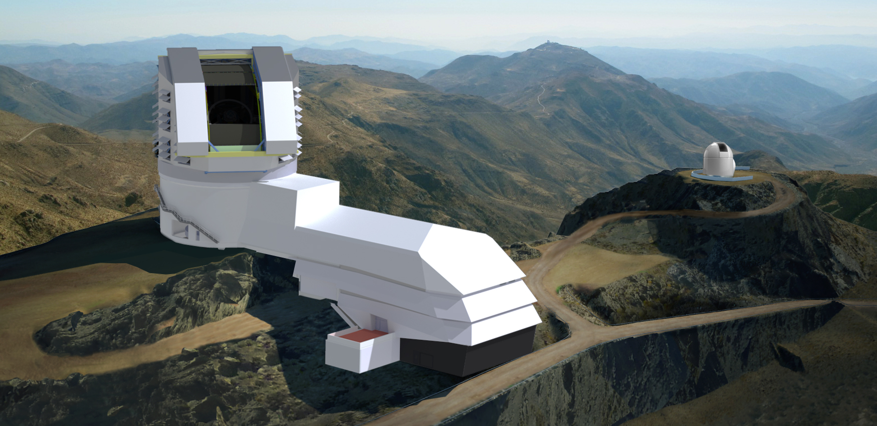
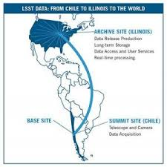
Question 2
Concerns over productivity and programmability are justified
Heterogeneity has enabled new scales and new science processes
Xloop, urgent HPC, etc
New application models
Need to understand how AI fits into science discovery process
Insufficient to say they’re going to run specific algorithm
Need to understand the overall problem they’re trying to solve
Source: lsst.org
It matters how we deploy heterogeneity and application components
This complicates productivity
Many more things to consider, especially in data plane

Slide 5
Question 3
Want to let users focus on algorithmic correctness
Fine tuning takes a long time and generally improves performance on the margins
Need modernized way of mapping apps and hardware
Becomes intractable for end users to map so many app and hardware components
Compute resource balance based on discovery of resources vs. problem space
Adjust as needed
Opportunities for co-design around understanding intent and goals, and using middleware/runtimes to address complicated mappings between app and hardware components
Source:
Illinois.edu
5

Slide 6
Thank you

