Slide 1
A Discussion of CPU vs. GPU

Slide 2
CUDA Real “Hardware”
 | Intel Core 2 Extreme QX9650 | NVIDIA GeForce GTX 280 | NVIDIA GeForce GTX 480
Transistors | 820 million | 1.4 billion | 3 billion
Processor frequency | 3 GHz | 1296 MHz | 1401 MHz
Cores | 4 | 240 | 480
Cache/Shared Memory | 6 MB x 2 | 16 KB x 30 | 16KB
Threads executed per cycle | 4 | 240 | 480
Active hardware threads | 4 | 30720 | 61440
Peak FLOPS | 96 GFLOPS | 933 GFLOPS | 1344 GFLOPS
Memory controllers | off-die | 8 x 64 bit | 8 x 64 bit
Memory bandwidth | 12.8 GBps | 141.7 GBps | 177.4 GBps

Slide 3
CPU vs. GPU
Theoretic Peak Performance
*Graph from the NVIDIA CUDA Programmers Guide, http://nvidia.com/cuda

Slide 4
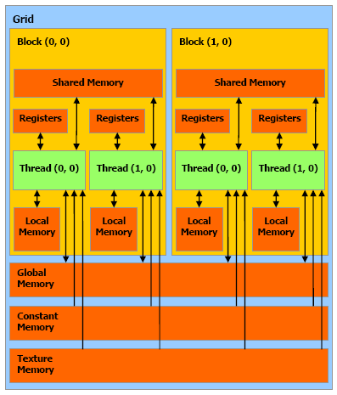
CUDA Memory Model

Slide 5
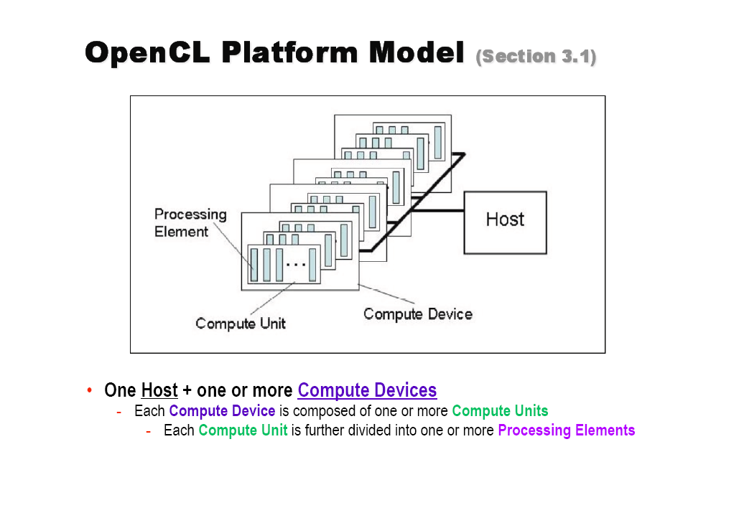
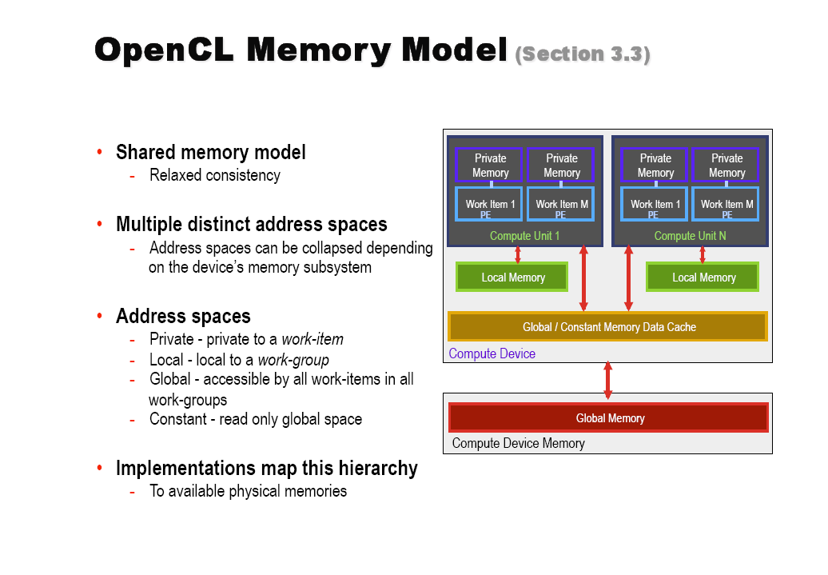
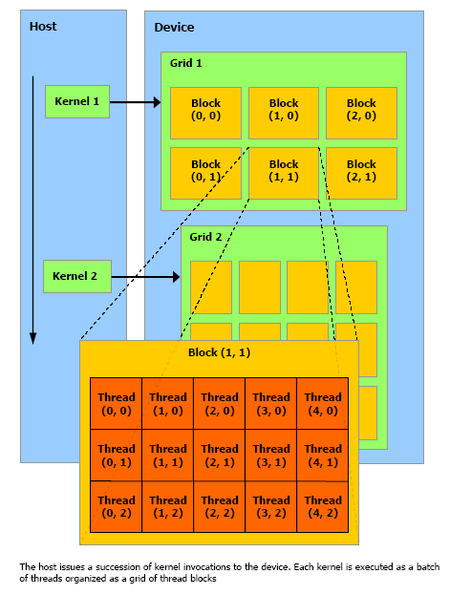
CUDA Programming Model

Slide 6
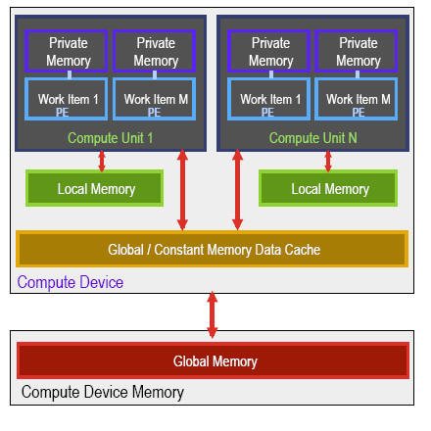
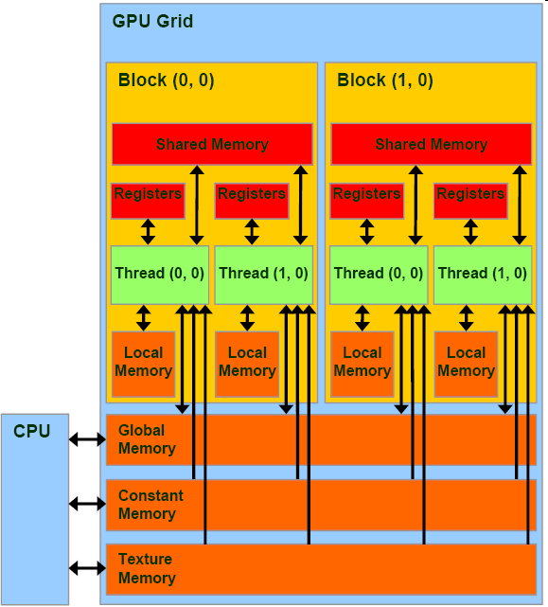
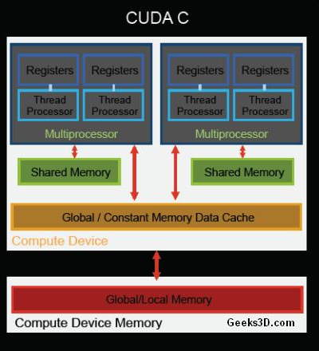
Memory Model Comparison
OpenCL CUDA

Slide 7
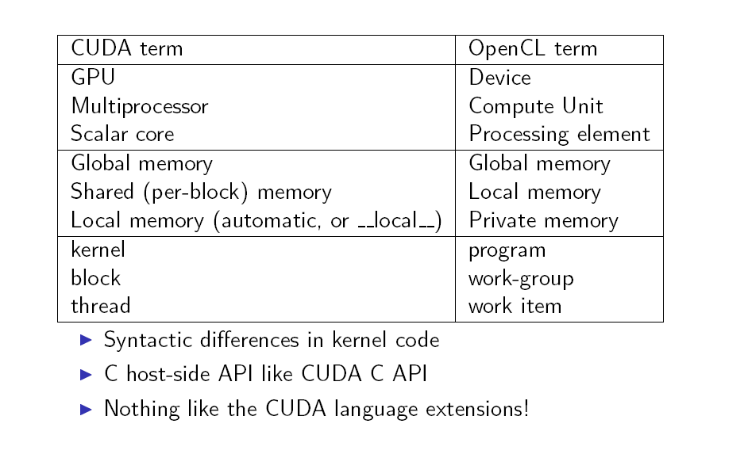
CUDA vs OpenCL

Slide 8
A Control-structure Splitting Optimization for GPGPU
Jakob Siegel, Xiaoming Li
Electrical and Computer Engineering Department
University of Delaware

Slide 9
CUDA Hardware and Programming Model
Grid of Thread Blocks
Blocks mapped to Streaming
Multiprocessors (SM)
SIMT
Manages threads in
warps of 32
Maps threads to
Streaming Processors (SP)
Threads start together
but are free to branch
*Graph from the NVIDIA CUDA Programmers Guide, http://nvidia.com/cuda

Slide 10
Thread Batching: Grids and Blocks
A kernel is executed as a grid of thread blocks
  All threads share data memory space
A thread block is a batch of threads that can cooperate with each other by:
  Synchronizing their execution
    For hazard-free shared memory accesses
  Efficiently sharing data through a low latency shared memory
Two threads from two different blocks cannot cooperate
Host
Device
Grid 1
Kernel 1
Block
(0, 0)
Block
(1, 0)
Block
(2, 0)
Block
(0, 1)
Block
(1, 1)
Block
(2, 1)
Grid 2
Kernel 2
Block (1, 1)
Thread
(0, 0)
Thread
(1, 0)
Thread
(2, 0)
Thread
(3, 0)
Thread
(4, 0)
Thread
(0, 1)
Thread
(1, 1)
Thread
(2, 1)
Thread
(3, 1)
Thread
(4, 1)
Thread
(0, 2)
Thread
(1, 2)
Thread
(2, 2)
Thread
(3, 2)
Thread
(4, 2)
*Graph from the NVIDIA CUDA Programmers Guide, http://nvidia.com/cuda

Slide 11
What to Optimize?
Occupancy?
  Most say that the maximal occupancy is the goal.
What is occupancy?
    Number of threads that actively run in a single cycle.
    In SIMT, things change.
Examine a simple code segment
  If (…)
    …
  Else
    …

Slide 12
SIMT and Branches
(like SIMD)
If all threads of
a warp execute
the same branch
there is no
negative effect.
Instruction unit
SP
SP
SP
SP
if {
}
time

Slide 13
SIMT and Branches
But if only one
thread executes
the other branch
every thread has
to step though all
the instructions of
both branches.
Instruction unit
SP
SP
SP
SP
if {
} else {
}
time

Slide 14
Occupancy
Ratio of active warps per multiprocessor to the possible maximum.
Effected by :
  shared memory usage
  (16KB/MP*)
  registers usage
  (8192reg/MP*)
  block size
  (512 t/b*)
* For a NVIDIA G80 GPU compute model v1.1

Slide 15
Occupancy and Branches
What if the register pressure of the two equally computational intense branches differ?
If-branch: 5 registers
Kernel: 5 registers
else-branch: 7 registers
This adds up to a maximum simultaneous usage of 12 registers
→ Limits Occupancy to 67% for a block size of 256 t/b

Slide 16
Branch-Splitting: Example
branchedkernel() {
if condition
load data for if branch
perform calculations
else
load data for else branch
perform calculations
end if
}
if-kernel() {
if condition
load all input data
perform calculations
end if
}
else-kernel() {
if !condition
load all input data
perform calculations
end if
}

Slide 17
Branch-Splitting
Idea: Splitting the kernel into two kernels
  Each new kernel contains a branch of the original kernel
  Adds overhead for:
    additional kernel invocation
    additional memory operations
  Still all threads have to execute both branches
  → But: One Kernel runs with 100% occupancy

Slide 18
Synthetic Benchmark:
Branch-Splitting
branchedkernel() {
load decision mask
load data used by all branches
if decision mask[tid] == 0
load data for if branch
perform calculations
else // mask == 1
load data for else branch
perform calculations
end if
}
if-kernel() {
load decision mask
if decision mask[tid] == 0
load all input data
perform calculations
end if
}
else-kernel() {
load decision mask
if decision mask[tid] == 1
load all input data
perform calculations
end if
}

Slide 19
Synthetic Benchmark:
Linear Growth Decision Mask
Decision Mask:
Binary mask that defines for each data element which branch to take.
Notes:
Bigger arrow + legend

Slide 20
Synthetic Benchmark:
Linear Growing Mask
Branched version runs with
67% occupancy
Split version:
If-kernel 100%
Else-kernel 67%
else branch executions

Slide 21
Synthetic Benchmark:
Random Filled Decision Mask
Decision Mask:
Binary mask that defines for each data element which branch to take.
Notes:
Bigger arrow + legend

Slide 22
Synthetic Benchmark:
Random Mask
Branch execution according to
a randomly filled decision mask
Worst case single kernel version
=
Best case for the split version
  Every thread steps through the
  Instructions of both branches
15%
else branch executions

Slide 23
Synthetic Benchmark:
Random Mask
Branched version:
every thread executes both
branches and the kernel runs
at 67% occupancy
Split version:
every thread executes both
kernels but one kernel runs at
100% occupancy the other one
at 67%
else branch executions

Slide 24
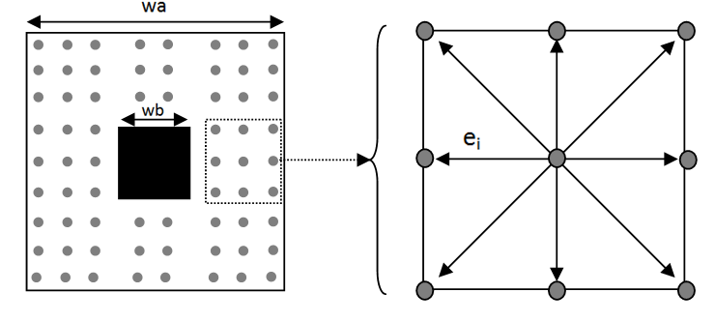
Benchmark: Lattice Boltzmann Method (LBM)
The LBM models Boltzmann particle dynamics on a 2D or 3D lattice.
A microscopically inspired method designed to solve macroscopic ﬂuid dynamics problems.

Slide 25
LBM Kernels (I)
loop_boundary_kernel(){
load geometry
load input data
if geometry[tid] == solid boundary
for(each particle on the boundary)
work on the boundary rows
work on the boundary columns
store result
}

Slide 26
LBM Kernels (II)
branch_velocities_densities_kernel(){
load geometry
load input data
if particles
load temporal data
for(each particle)
if geometry[tid] == solid boundary
load temporal data
work on boundary
store result
else
load temporal data
work on fluid
store result
}

Slide 27
Splited LBM Kernels
if_velocities_densities_kernel(){
load geometry
load input data
if particles
load temporal data
for(each particle)
if geometry[tid] == boundary
load temporal data
work on boundary
store result
}
else_velocities_densities_kernel(){
load geometry
load input data
if particles
load temporal data
for(each particle)
if geometry[tid] == fluid
load temporal data
work on fluid
store result
}

Slide 28
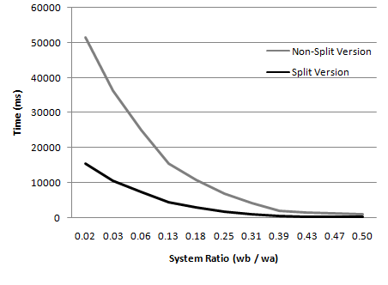
LBM Results (128*128)

Slide 29
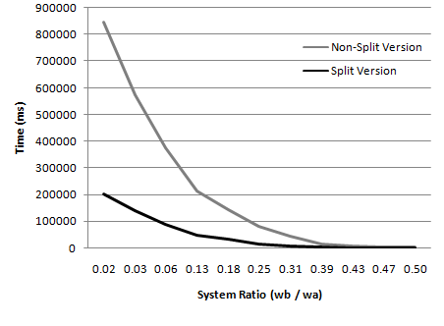
LBM Results (256*256)

Slide 30
Conclusion
Branches are generally a performance bottleneck in any SIMT architecture
Branch Splitting might seem and probably is counter productive on most architectures other than a GPU
Experiments show that in many cases the gain in occupancy can increase the performance
For a LBM implementation we reduced the execution time by more than 60% by applying Branch Splitting

Slide 31
Software-based predication for AMD GPUs
Ryan Taylor
Xiaoming Li
University of Delaware

Slide 32
Introduction
Current AMD GPU:
  SIMD (Compute) Engines:
    Thread processors per SIMD engine
      RV770 and RV870 => 16 TPs/SIMD engine
      5-wide VLIW processor (compute cores)
  Threads run in Wavefronts
    Multiple threads per Wavefront depending on architecture
      RV770 and RV870 => 64 Threads/Wavefront
    Threads organized into quads per thread processor
    Two Wavefront slots/SIMD engine (odd and even)

Slide 33
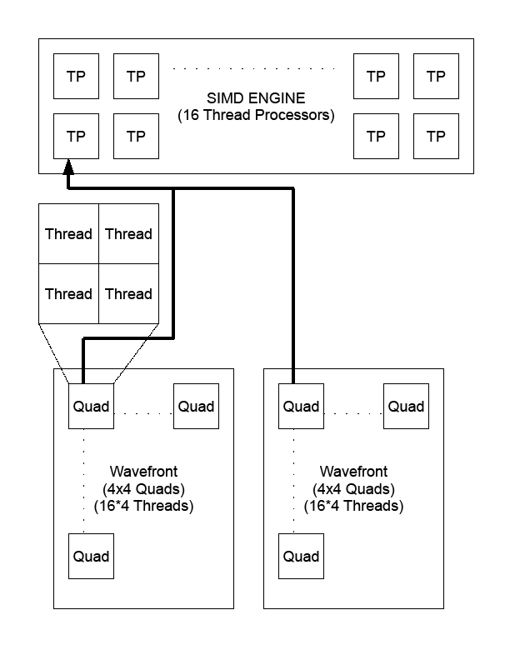
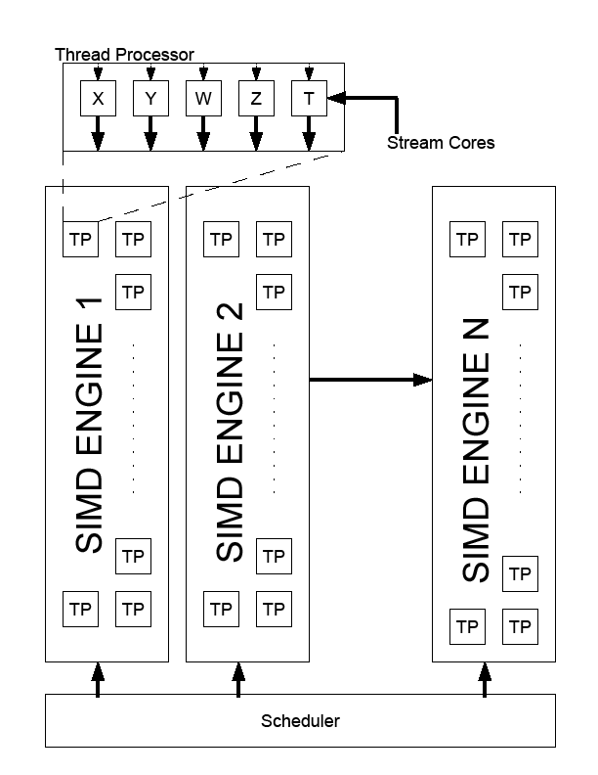
AMD GPU Arch. Overview
Hardware Overview
Thread Organization

Slide 34
Motivation
Wavefront Divergence
  If threads in a Wavefront diverge then the execution time for each path is serialized
    Can cause performance degradation
Increase ALU Packing
  AMD GPU ISA doesn’t allow for instruction packing across control flow operations
Reduce Control Flow
  Reduce the number of control flow clauses to reduce clause switching

Slide 35
Motivation
This example uses hardware predication to decide whether or not to execute a particular path, notice there is no packing across the two code paths.
if (cf == 0)
{
t0 = a + b;
t1 = t0 + a;
t2 = t1 + t0;
e= t2 + t1;
}
else
{
t0 = a - b;
t1 = t0 - a;
t2 = t1 – t0;
e= t2 – t1;
}
01 ALU_PUSH_BEFORE: ADDR(32) CNT(2)
3 x: SETE_INT R1.x, R1.x, 0.0f
4 x: PREDNE_INT ____, R1.x, 0.0f UPDATE_PRED
02 ALU_ELSE_AFTER: ADDR(34) CNT(66)
5 y: ADD T0.y, R2.x, R0.x
6 x: ADD T0.x, R2.x, PV5.y
.....
03 ALU_POP_AFTER: ADDR(100) CNT(66)
71 y: ADD T0.y, R2.x, -R0.x
72 x: ADD T0.x, -R2.x, PV71.y
...

Slide 36
Transformation
if (cond)
ALU_OPs1;
output = ALU_OPs1;
else
ALU_OPs2;
output = ALU_OPs2;
if (cond)
pred1 = 1;
else
pred2 = 1;
ALU_OPS1;
ALU_OPS2;
output = ALU_OPS1 *pred1+ALU_OPS2*pred2;
Before Transformation
After Transformation
This example shows the basic idea of the software-based predication technique.

Slide 37
Approach – Synthetic Benchmark
if (cf == 0)
{
t0 = a + b;
t1 = t0 + a;
t0 = t1 + t0;
e= t0 + t1;
}
else
{
t0 = a - b;
t1 = t0 - a;
t0 = t1 – t0;
e= t0 – t1;
}
t0 = a + b;
t1 = t0 + a;
t0 = t1 + t0;
end = t0+ t1;
t0 = a - b;
t1 = t0 - a;
t0 = t1 – t0;
if (cf == 0)
pred1 = 1.0f;
else
pred2 = 1.0f;
e = (t0-t1)*pred2 + end*pred1;
Before Transformation
After Transformation

Slide 38
Approach – Synthetic Benchmark
Reduction in Clauses from 3 to 1
01 ALU_PUSH_BEFORE: ADDR(32) CNT(2)
3 x: SETE_INT R1.x, R1.x, 0.0f
4 x: PREDNE_INT ____, R1.x, 0.0f UPDATE_PRED
02 ALU_ELSE_AFTER: ADDR(34) CNT(66)
5 y: ADD T0.y, R2.x, R0.x
6 x: ADD T0.x, R2.x, PV5.y
7 w: ADD T0.w, T0.y, PV6.x
8 z: ADD T0.z, T0.x, PV7.w
03 ALU_POP_AFTER: ADDR(100) CNT(66)
9 y: ADD T0.y, R2.x, -R0.x
10 x: ADD T0.x, -R2.x, PV71.y
11 w: ADD T0.w, -T0.y, PV72.x
12 z: ADD T0.z, -T0.x, PV73.w
13 y: ADD T0.y, -T0.w, PV74.z
01 ALU: ADDR(32) CNT(121)
3 y: ADD T0.y, R2.x, -R1.x
z: SETE_INT ____, R0.x, 0.0f VEC_201
w: ADD T0.w, R2.x, R1.x
t: MOV R3.y, 0.0f
4 x: ADD T0.x, -R2.x, PV3.y
y: CNDE_INT R1.y, PV3.z, (0x3F800000, 1.0f).x, 0.0f
z: ADD T0.z, R2.x, PV3.w
w: CNDE_INT R1.w, PV3.z, 0.0f, (0x3F800000, 1.0f).x
5 y: ADD T0.y, T0.w, PV4.z
w: ADD T0.w, -T0.y, PV4.x
6 x: ADD T0.x, T0.z, PV5.y
z: ADD T0.z, -T0.x, PV5.w
7 y: ADD T0.y, -T0.w, PV6.z
w: ADD T0.w, T0.y, PV6.x
Two 20% Packed Instructions
One 40% Packed Instruction

Slide 39
Results – Synthetic Benchmarks
Non-Predicated Kernels
 | Instruction Type – Number of Instructions
Packing Percent | ALU | TEX | CF
20% (Float) | 135 | 3 | 6
40% (Float2) | 135 | 3 | 8
60% (Float3) | 135 | 3 | 8
80% (Float4) | 134 | 3 | 9
Predicated Kernels
 | Instruction Type – Number of Instructions
Packing Percent | ALU | TEX | CF
20% (Float) | 68 | 3 | 4
40% (Float2) | 68 | 3 | 5
60% (Float3) | 83 | 3 | 6
80% (Float4) | 109 | 3 | 7
A reduction in ALU instructions improves performance in ALU bound kernels. Control flow reduction improves performance by reducing clause switching latency.

Slide 40
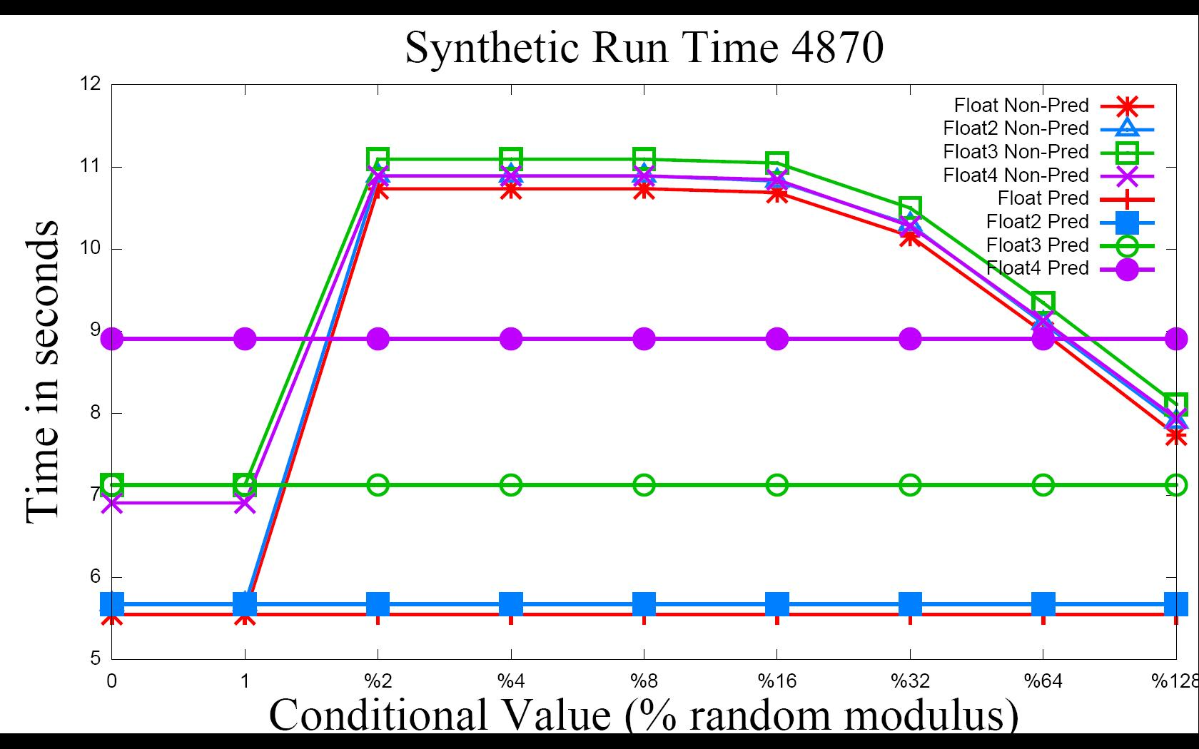
Results – Synthetic Benchmark

Slide 41
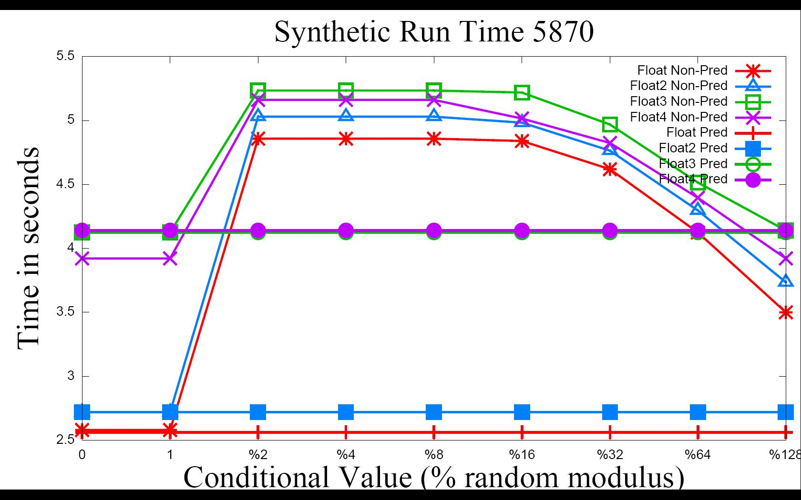
Results – Synthetic Benchmark

Slide 42
Results – Synthetic Benchmark
 | Pre-Transformation Packing Percentage
Divergence | 20% | 40% | 60% | 80%
No Divg. | 0/0 | 0/0 | 0/0 | -22.5/-6.5
1 out of 2 Threads | 93.5/89.6 | 92/85 | 55.7/26.9 | 57.7/20.3
1 out of 4 Threads | 93.5/89.6 | 92/85 | 55.7/26.9 | 57.7/20.3
1 out of 8 Threads | 93.5/89.6 | 92/85 | 55.7/26.9 | 57.7/20.3
1 out of 16 Threads | 92.6/88.9 | 90.9/83.3 | 55/26.5 | 21.7/15
1 out of 64 Threads | 61.9/61 | 59.5/58 | 31/9.5 | 2.4/3.7
1 out of 128 Threads | 39.4/36.6 | 39.1/37.3 | 13.8/.3 | -11/-6.5
Percent improvement in run time for varying packing ratios for 4870/5870

Slide 43
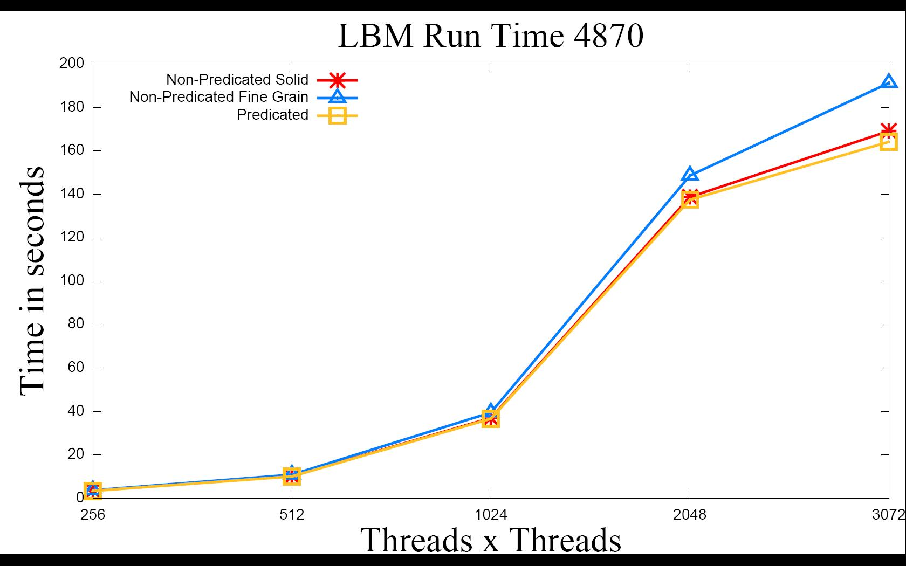
Results – Lattice Boltzmann Method

Slide 44
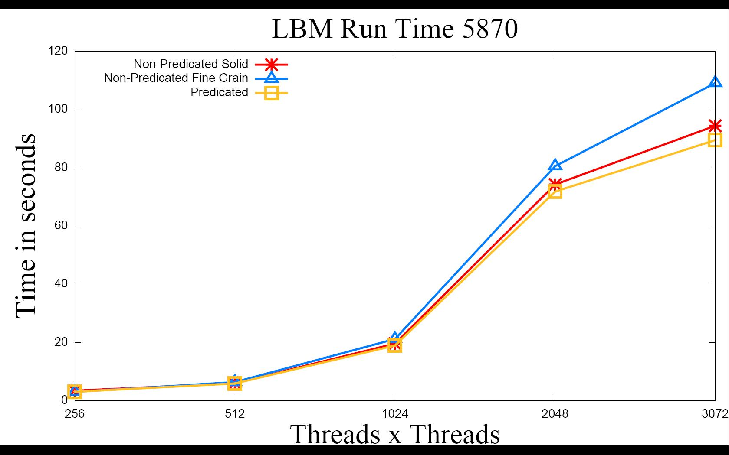
Results – Lattice Boltzmann Method

Slide 45
Results – Lattice Boltzmann Method
 | Domain Size X Domain Size
Divergence /GPU | 256 | 512 | 1024 | 2048 | 3072
Course Grain/4870 | 3.2 | 3.3 | 3.3 | 3.3 | 3.6
Fine Grain/4870 | 7.9 | 7.8 | 7.7 | 8.1 | 16.4
Course Grain/5870 | 3.3 | 3.4 | 3.3 | 3.3 | 5.5
Fine Grain/5870 | 3.3 | 8.5 | 11.6 | 12.1 | 21.8
Percent improvement when applying transformation to one path conditionals.

Slide 46
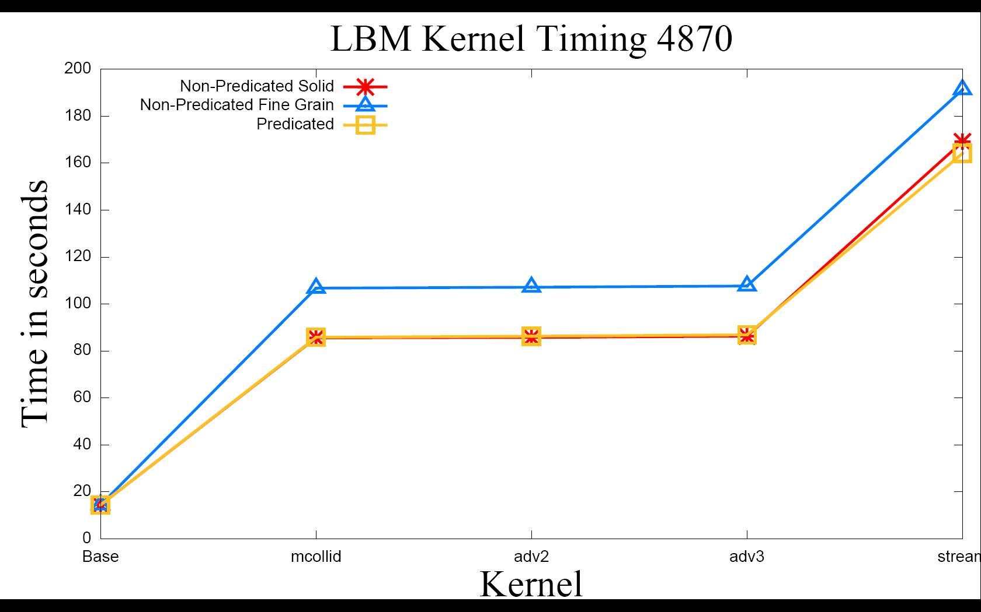
Results – Lattice Boltzmann Method

Slide 47
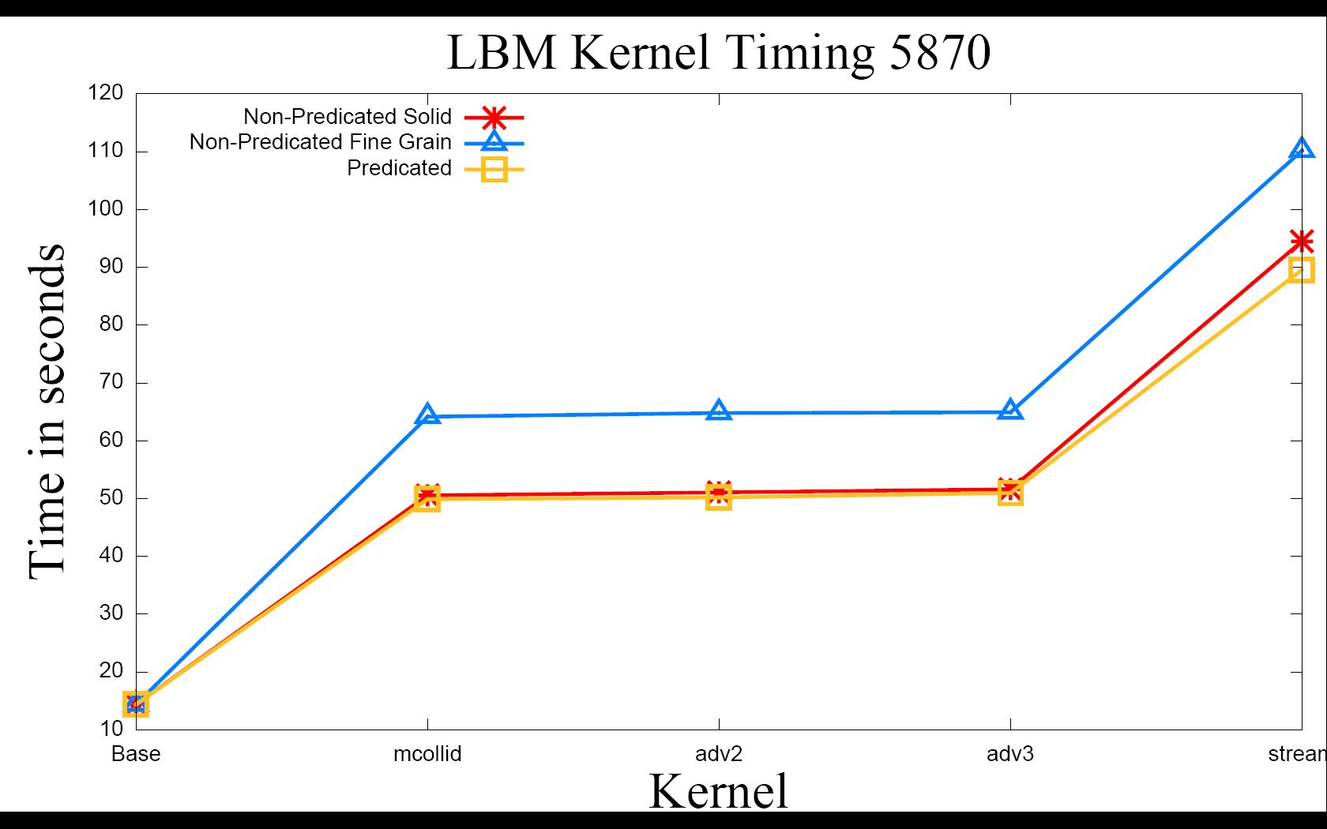
Results – Lattice Boltzmann Method

Slide 48
Results – Other (Preliminary)
N-queen Solver OpenCL (applied to one kernel)
  ALU Packing => 35.2% to 52%
  Runtime => 74.3s to 47.2s
  Control Flow Clauses => 22 to 9
Stream SDK OpenCL Samples
  DwtHaar1D
    ALU Packing => 42.6% to 52.44%
  Eigenvalue
    Avg Global Writes => 6 to 2
  Bitonic Sort
    Avg Global Writes => 4 to 2

Slide 49
Conclusion
Software based predication for AMD GPU
  Increases ALU packing
  Decreases Control Flow
    Clause switching
  Low overhead
    Few extra registers needed if any
    Few additional ALU operations needed
      Cheap on GPU
      Possibility to pack them in with other ALU operations
  Possible reduction in memory operations
    Combine writes/reads across paths
AMD recently introduced this technique in their OpenCL Programming Guide with Stream SDK 2.1

Slide 50
A Micro-benchmark Suite for AMD GPUs
Ryan Taylor
Xiaoming Li

Slide 51
Motivation
To understand behavior of major kernel characteristics
  ALU:Fetch Ratio
  Read Latency
  Write Latency
  Register Usage
  Domain Size
  Cache Effect
Use micro-benchmarks as guidelines for general optimizations
Little to no useful micro-benchmarks exist for AMD GPUs
Look at multiple generations of AMD GPU (RV670, RV770, RV870)

Slide 52
Hardware Background
Current AMD GPU:
  Scalable SIMD (Compute) Engines:
    Thread processors per SIMD engine
      RV770 and RV870 => 16 TPs/SIMD engine
      5-wide VLIW processors (compute cores)
  Threads run in Wavefronts
    Multiple threads per Wavefront depending on architecture
      RV770 and RV870 => 64 Threads/Wavefront
    Threads organized into quads per thread processor
    Two Wavefront slots/SIMD engine (odd and even)

Slide 53
AMD GPU Arch. Overview
Hardware Overview
Thread Organization

Slide 54
Software Overview
00 TEX: ADDR(128) CNT(8) VALID_PIX
0 SAMPLE R1, R0.xyxx, t0, s0 UNNORM(XYZW)
1 SAMPLE R2, R0.xyxx, t1, s0 UNNORM(XYZW)
2 SAMPLE R3, R0.xyxx, t2, s0 UNNORM(XYZW)
01 ALU: ADDR(32) CNT(88)
8 x: ADD ____, R1.w, R2.w
y: ADD ____, R1.z, R2.z
z: ADD ____, R1.y, R2.y
w: ADD ____, R1.x, R2.x
9 x: ADD ____, R3.w, PV1.x
y: ADD ____, R3.z, PV1.y
z: ADD ____, R3.y, PV1.z
w: ADD ____, R3.x, PV1.w
14 x: ADD T1.x, T0.w, PV2.x
y: ADD T1.y, T0.z, PV2.y
z: ADD T1.z, T0.y, PV2.z
w: ADD T1.w, T0.x, PV2.w
02 EXP_DONE: PIX0, R0
END_OF_PROGRAM
Fetch Clause
ALU Clause

Slide 55
Code Generation
Use CAL/IL (Compute Abstraction Layer/Intermediate Language)
  CAL: API interface to GPU
  IL: Intermediate Language
    Virtual registers
  Low level programmable GPGPU solution for AMD GPUs
  Greater control of CAL compiler produced ISA
  Greater control of register usage
Each benchmark uses the same pattern of operations (register usage differs slightly)

Slide 56
Code Generation - Generic
Reg0 = Input0 + Input1
While (INPUTS)
Reg[] = Reg[-1] + Input[]
While (ALU_OPS)
Reg[] = Reg[-1] + Reg[-2]
Output =Reg[];
R1 = Input1 + Input2;
R2 = R1 + Input3;
R3 = R2 + Input4;
R4 = R3 + R2;
R5 = R4 + R5;
…………..
…………..
…………..
R15 = R14 + R13;
Output1 = R15 + R14;

Slide 57
Clause Generation – Register Usage
Sample(32)
ALU_OPs Clause (use first 32 sampled)
Sample(8)
ALU_OPs Clause (use 8 sampled here)
Sample(8)
ALU_OPs Clause (use 8 sampled here)
Sample(8)
ALU_OPs Clause (use 8 sampled here)
Sample(8)
ALU_OPs Clause (use 8 sampled here)
Output
Sample(64)
ALU_OPs Clause (use first 32 sampled)
ALU_OPs Clause (use next 8)
ALU_OPs Clause (use next 8)
ALU_OPs Clause (use next 8)
ALU_OPs Clause (use next 8)
Output
Register Usage Layout
Clause Layout

Slide 58
ALU:Fetch Ratio
“Ideal” ALU:Fetch Ratio is 1.00
  1.00 means perfect balance of ALU and Fetch Units
    Ideal GPU utilization includes full use of BOTH the ALU units and the Memory (Fetch) units
  Reported ALU:Fetch ratio of 1.0 is not always optimal utilization
    Depends on memory access types and patterns, cache hit ratio, register usage, latency hiding... among other things

Slide 59
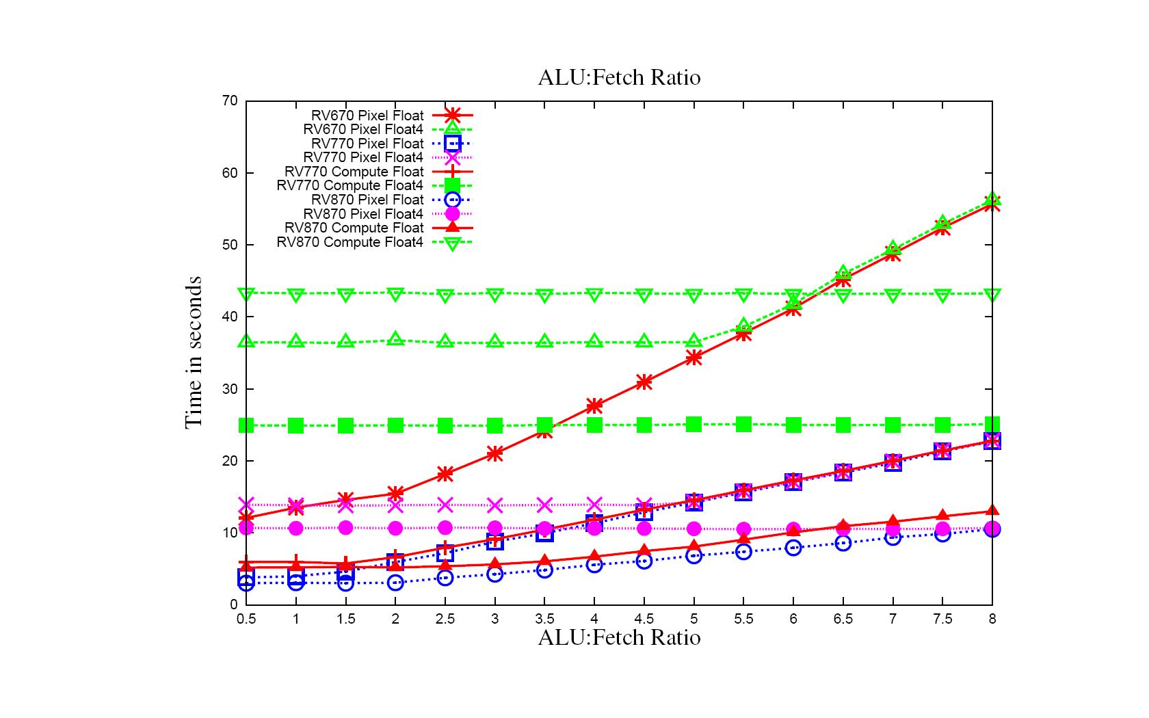
ALU:Fetch 16 Inputs 64x1 Block Size – Samplers
Lower Cache Hit Ratio

Slide 60
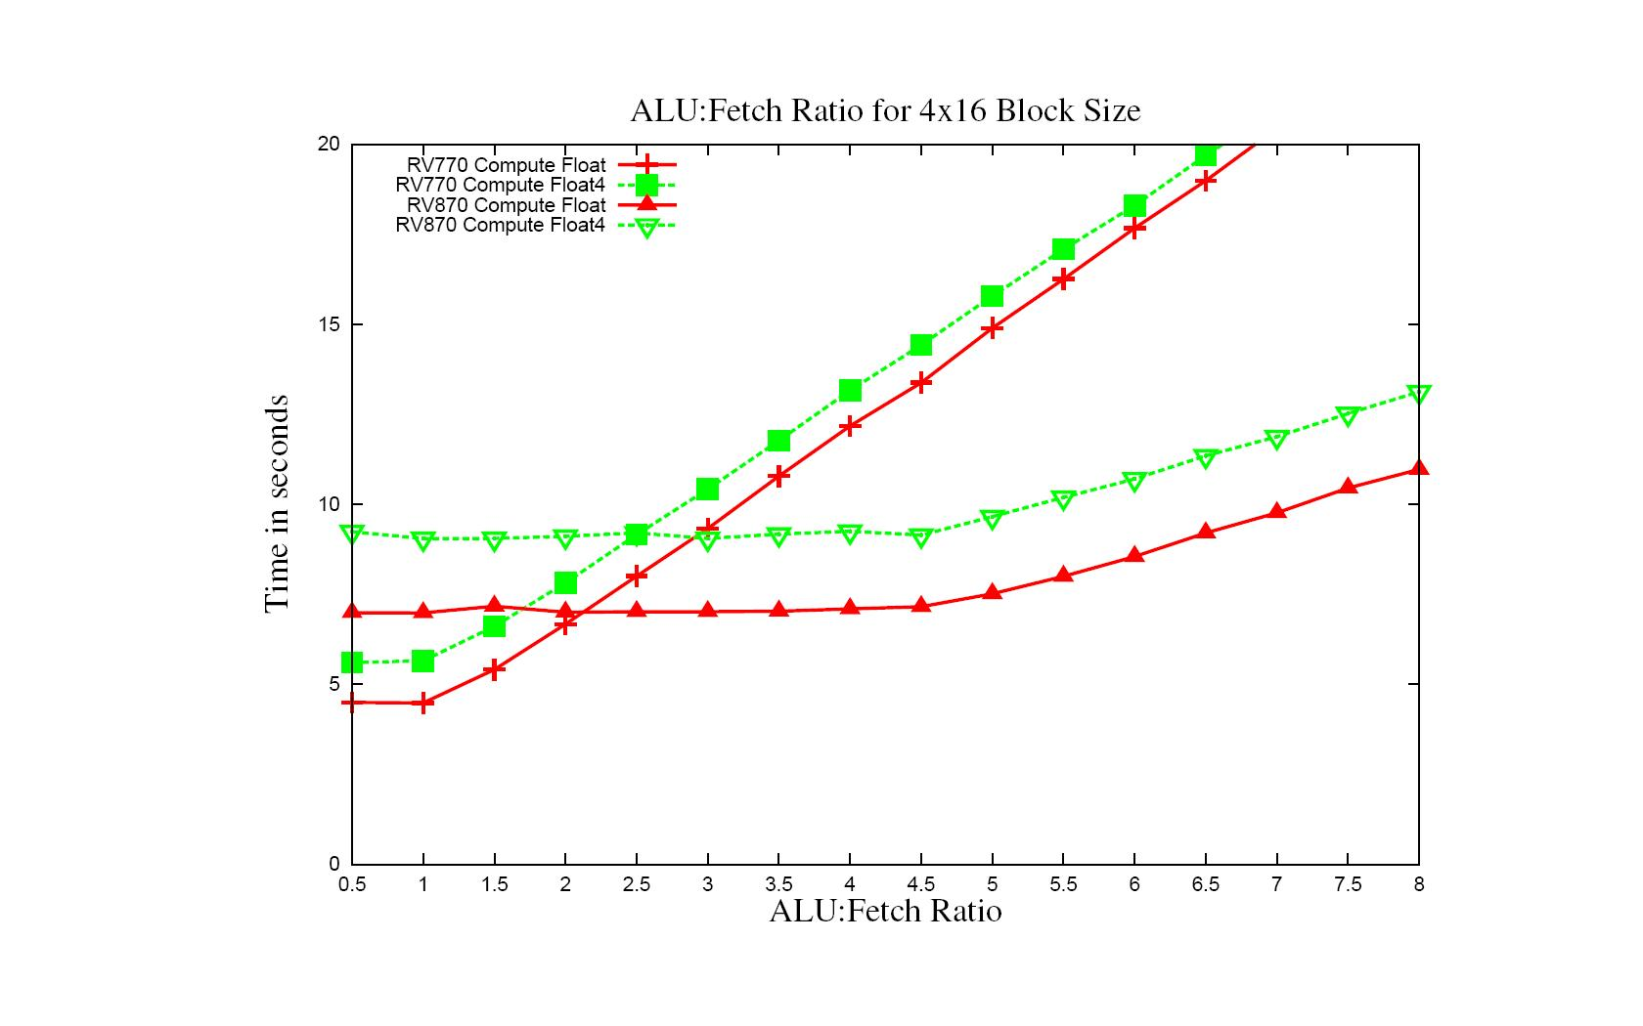
ALU:Fetch 16 Inputs 4x16 Block Size - Samplers

Slide 61
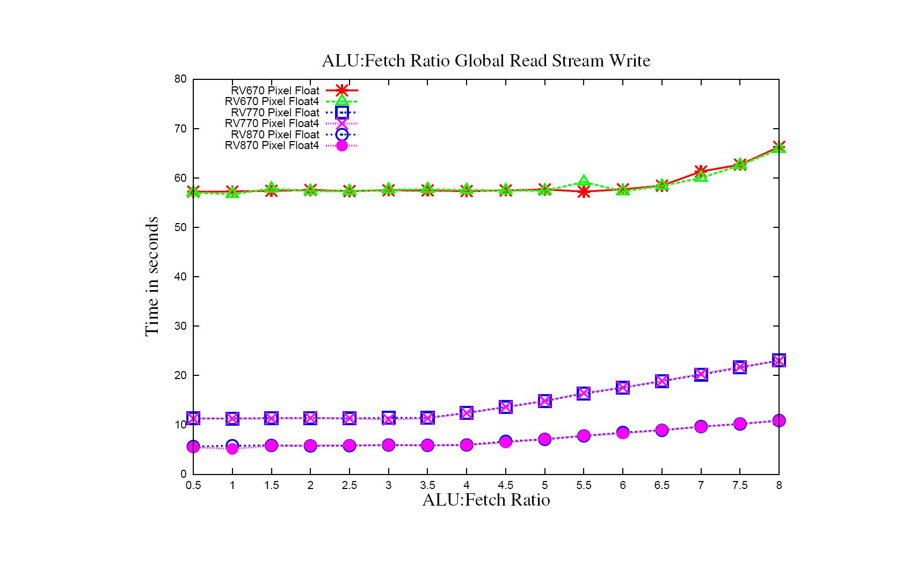
ALU:Fetch 16 Inputs Global Read and Stream Write

Slide 62
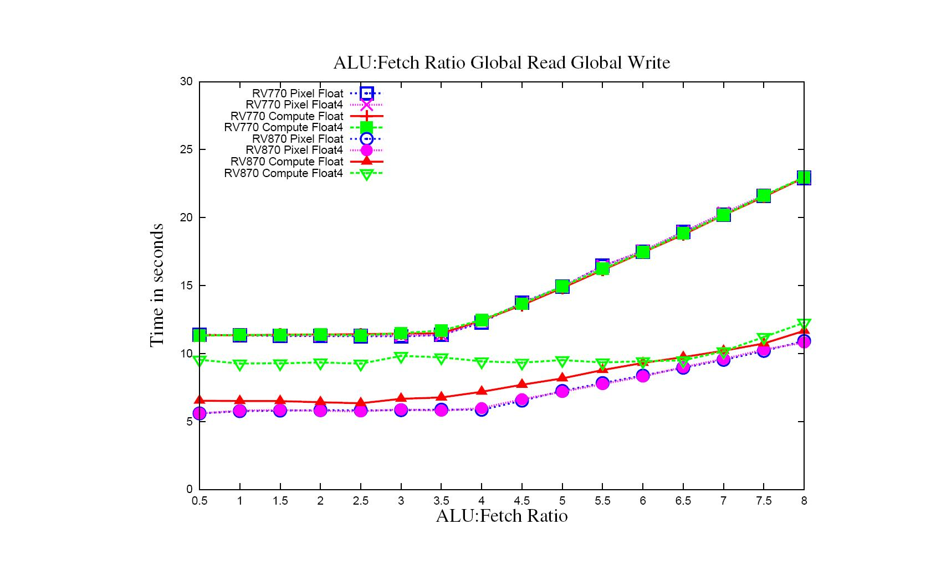
ALU:Fetch 16 Inputs Global Read and Global Write

Slide 63
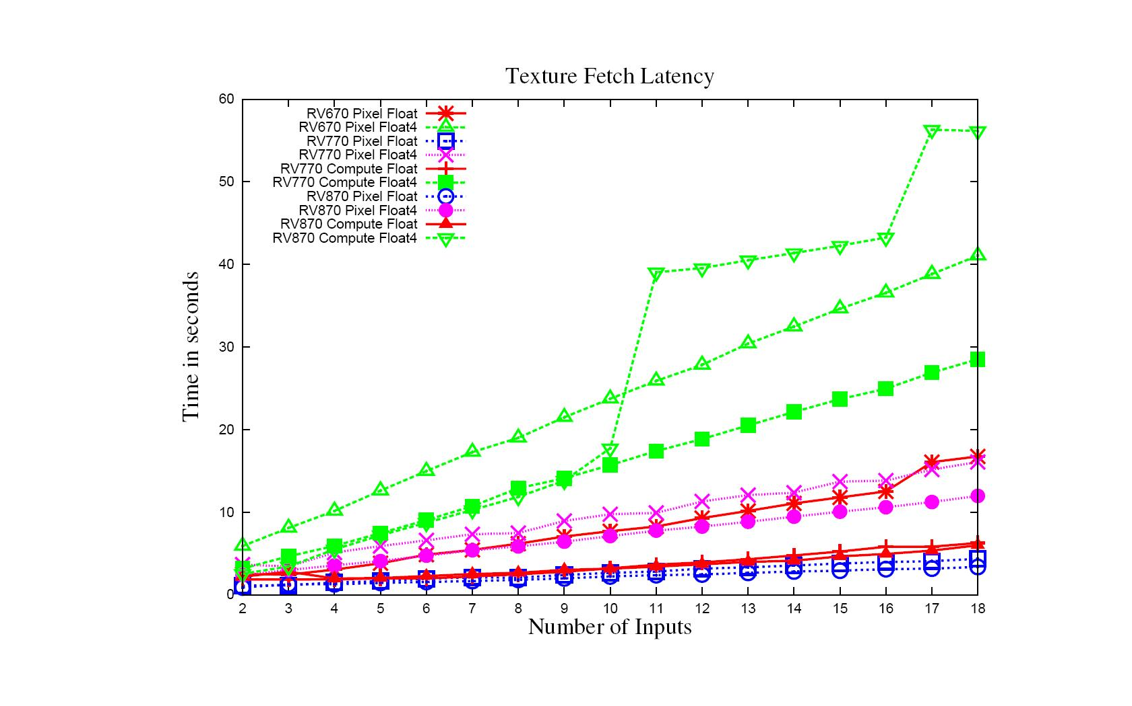
Input Latency – Texture Fetch 64x1
ALU Ops < 4*Inputs
Linear increase can be effected by cache hit ratio
Reduction in Cache Hit

Slide 64
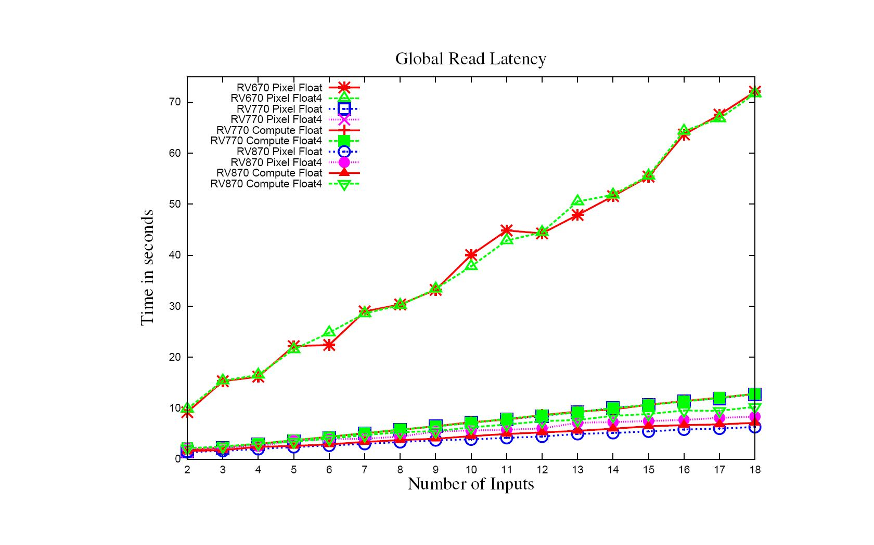
Input Latency – Global Read
ALU Ops < 4*Inputs
Generally linear increase with number of reads

Slide 65
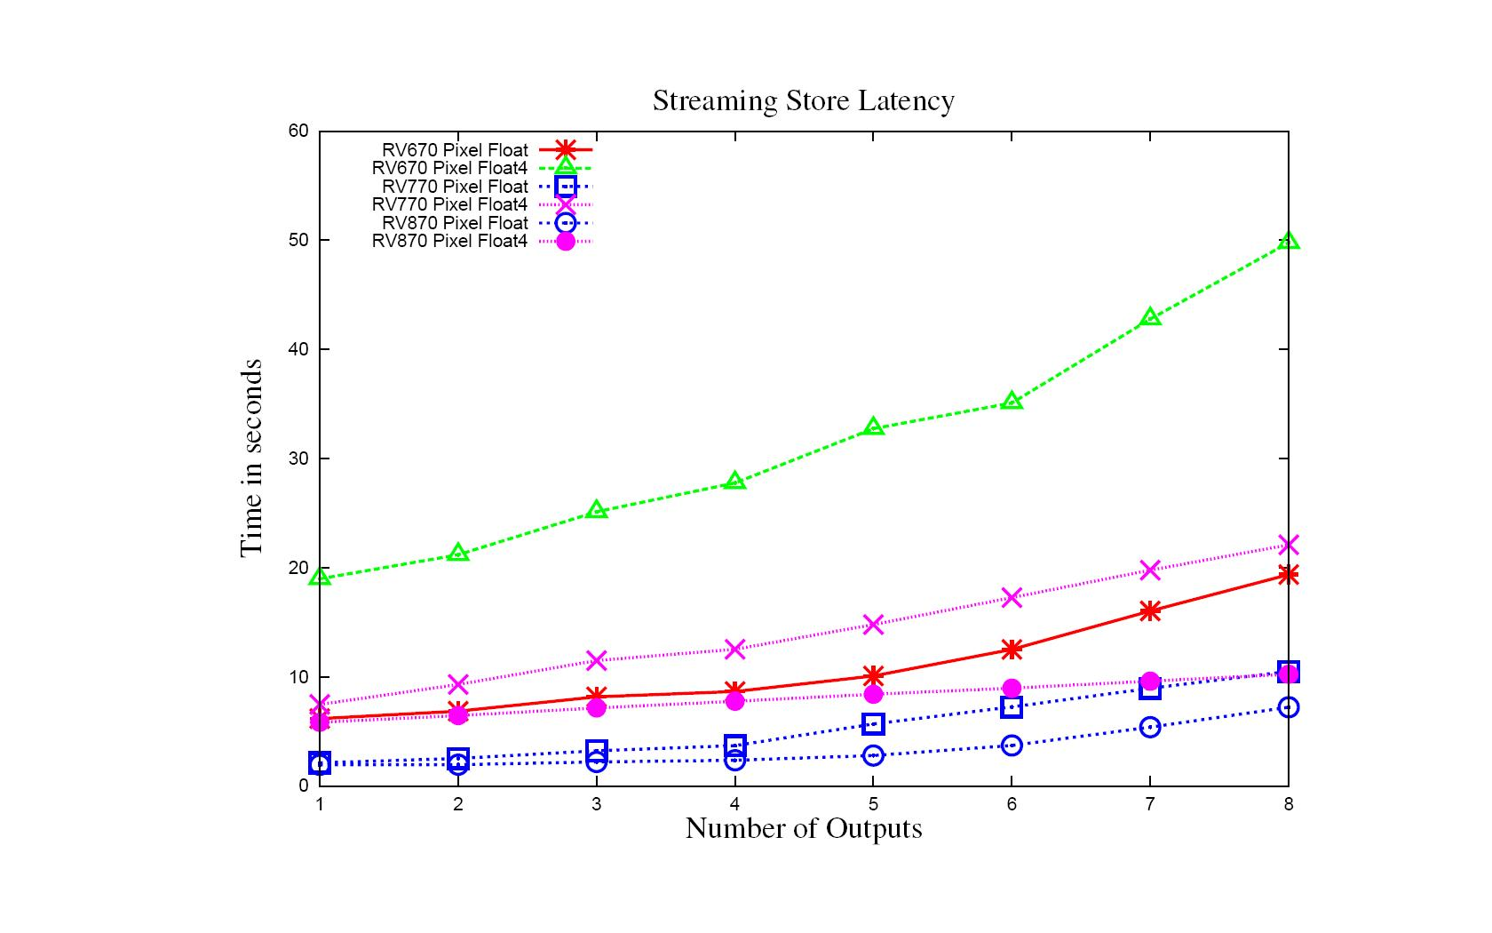
Write Latency – Streaming Store
ALU Ops < 4*Inputs
Generally linear increase with number of writes

Slide 66
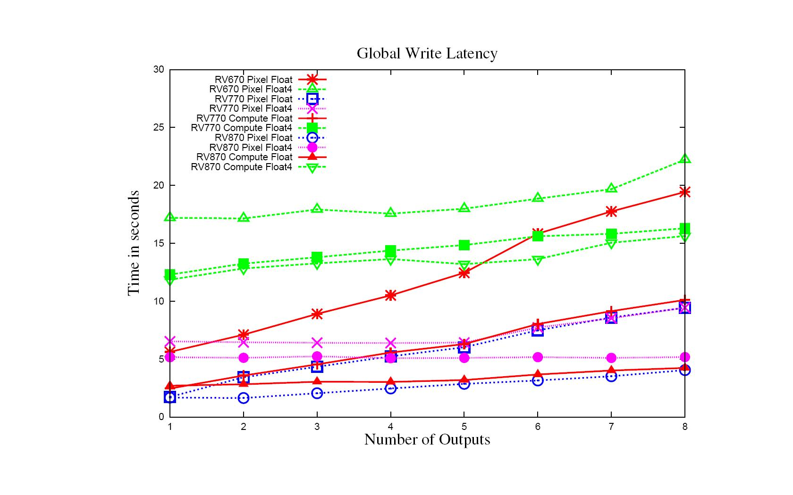
Write Latency – Global Write
ALU Ops < 4*Inputs
Generally linear increase with number of writes

Slide 67
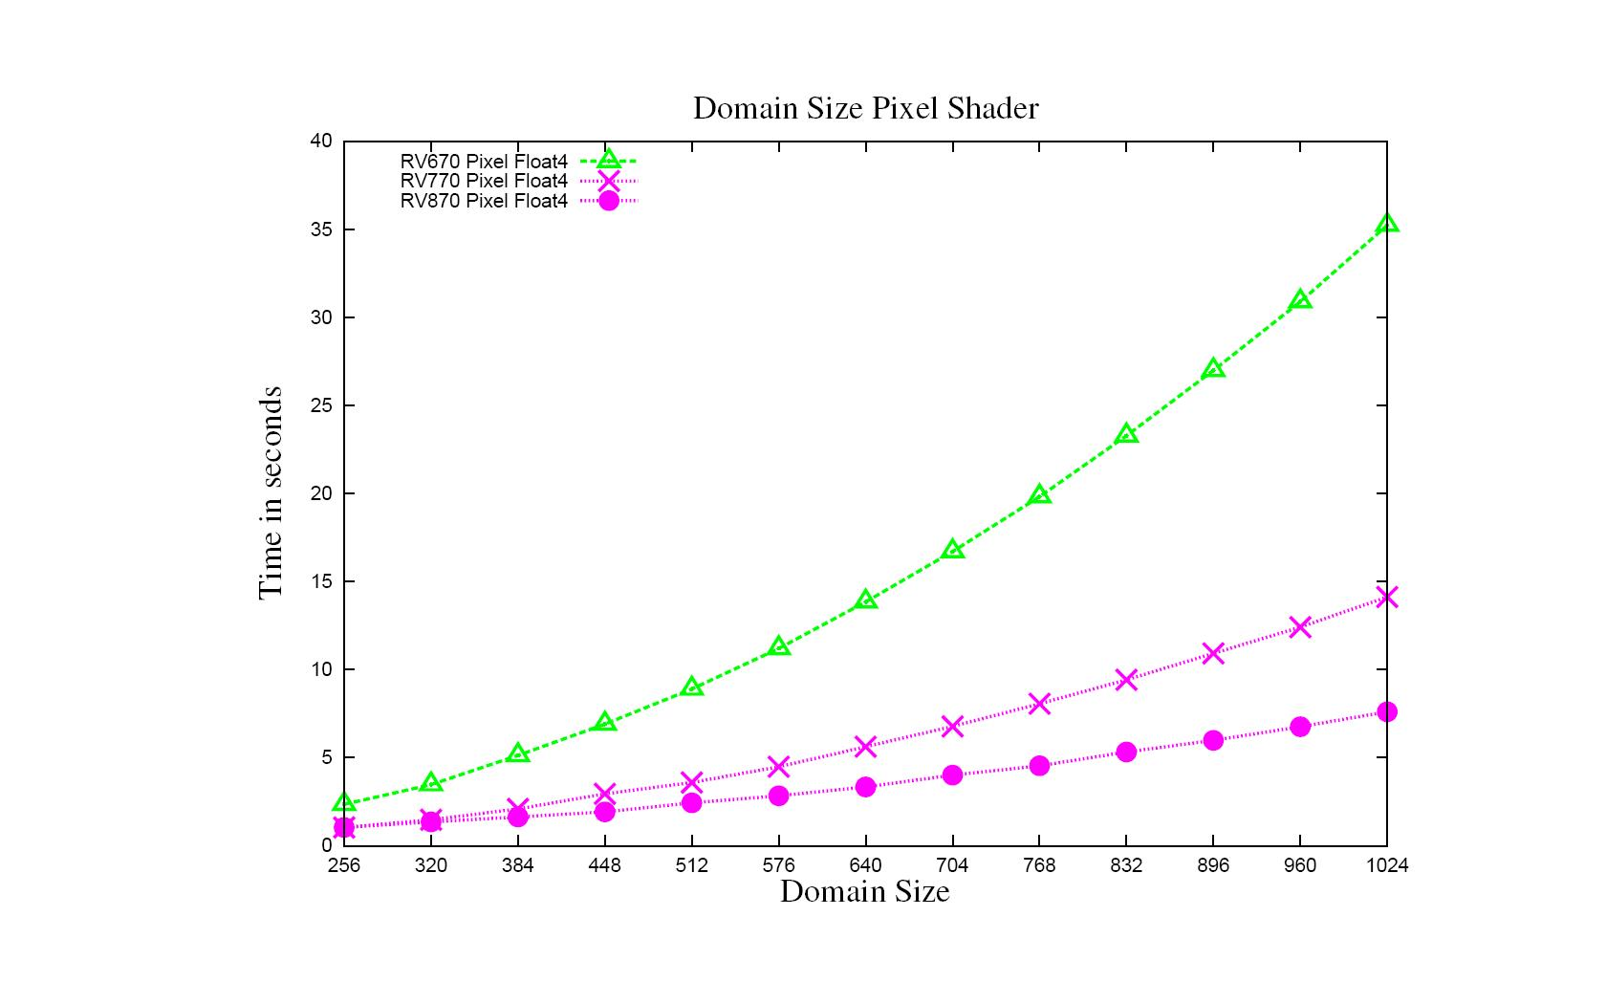
Domain Size – Pixel Shader
ALU:Fetch = 10.0, Inputs =8

Slide 68
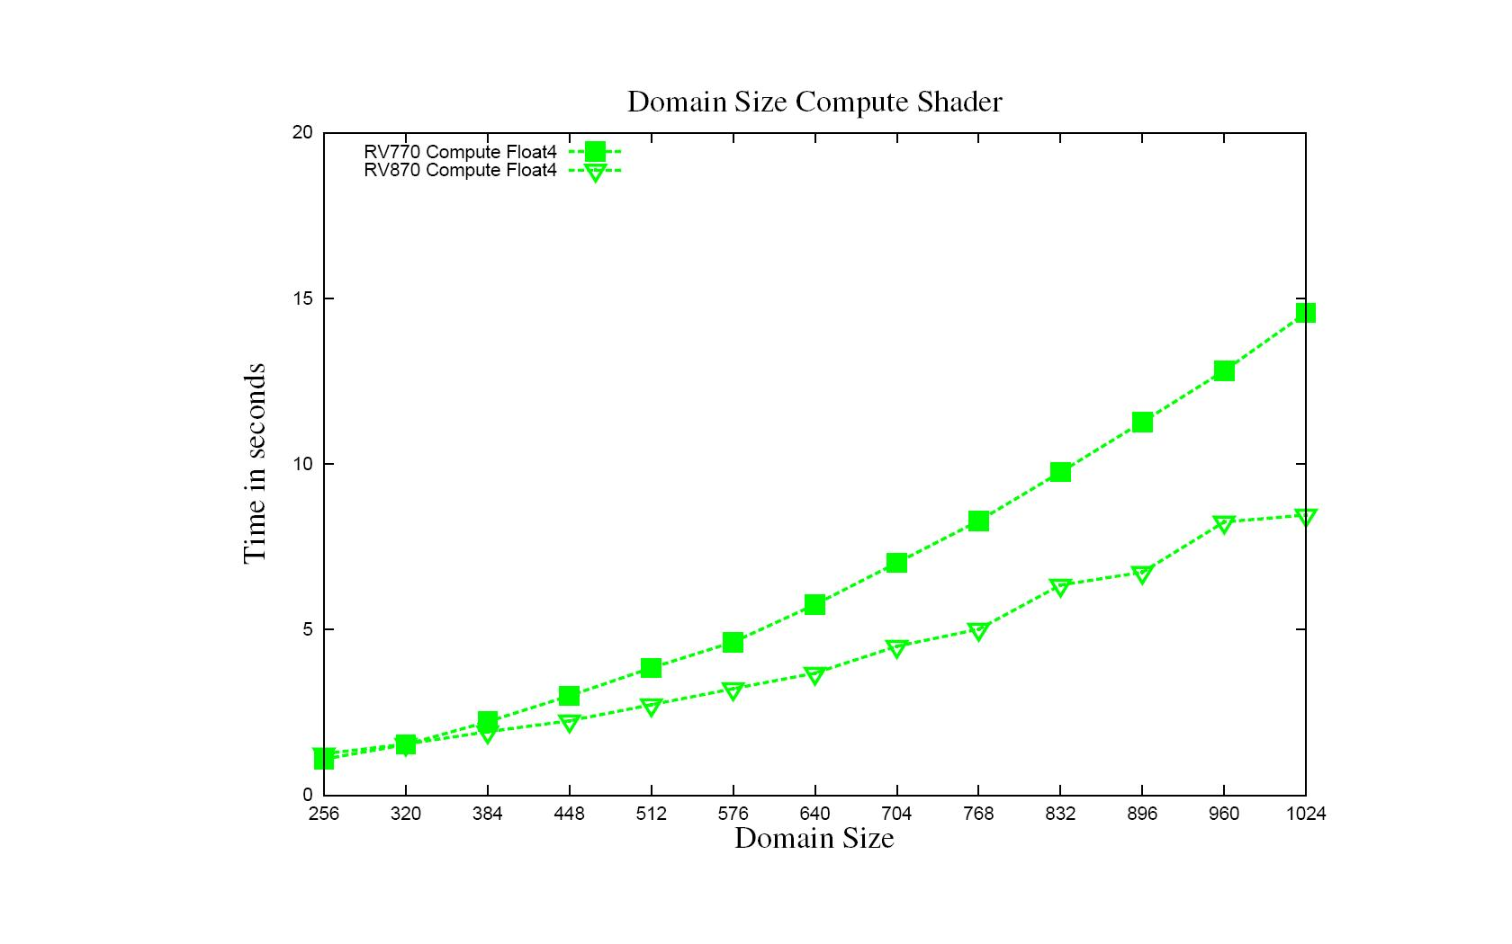
Domain Size – Compute Shader
ALU:Fetch = 10.0 , Inputs =8

Slide 69
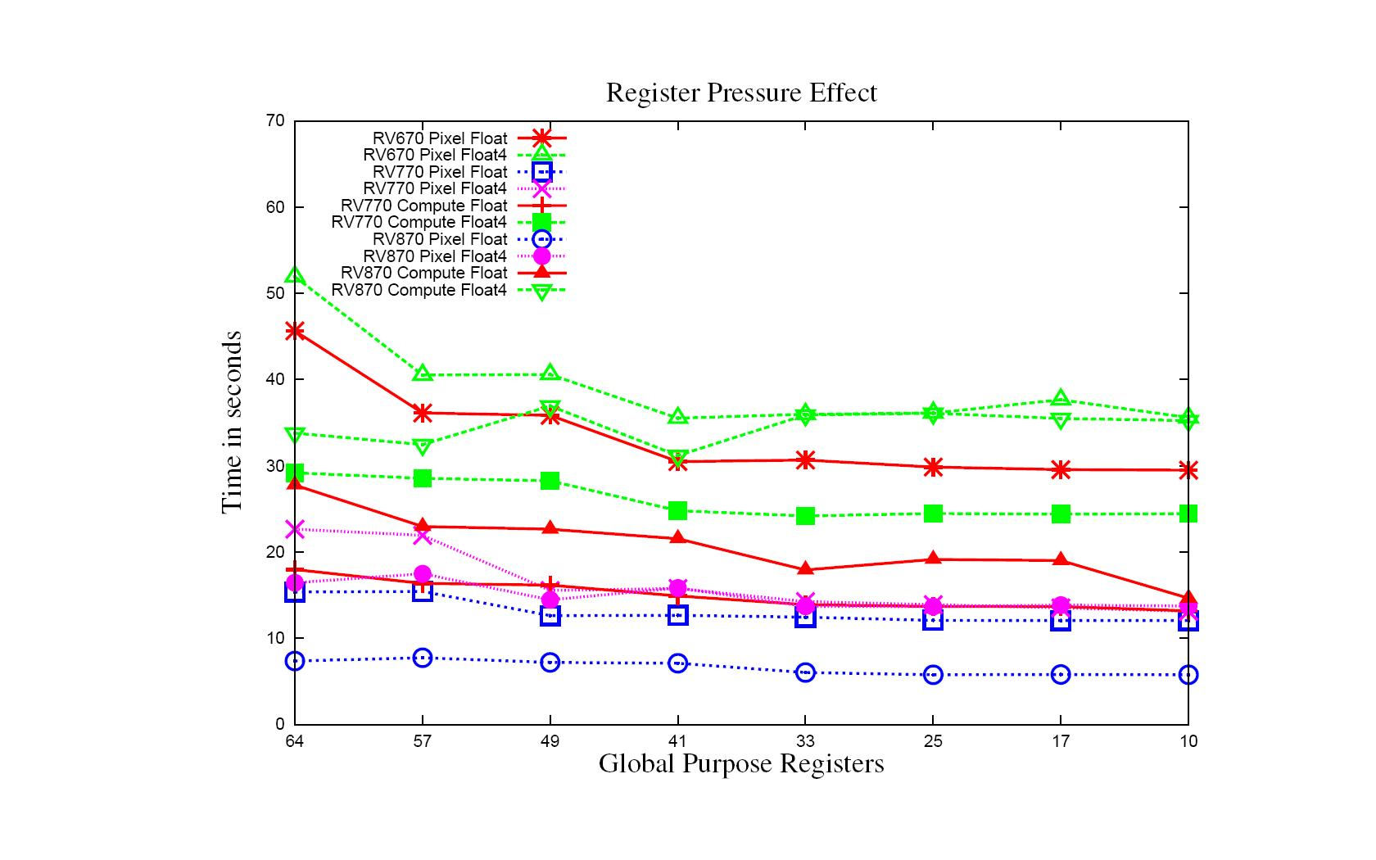
Register Usage – 64x1 Block Size
Overall Performance Improvement

Slide 70
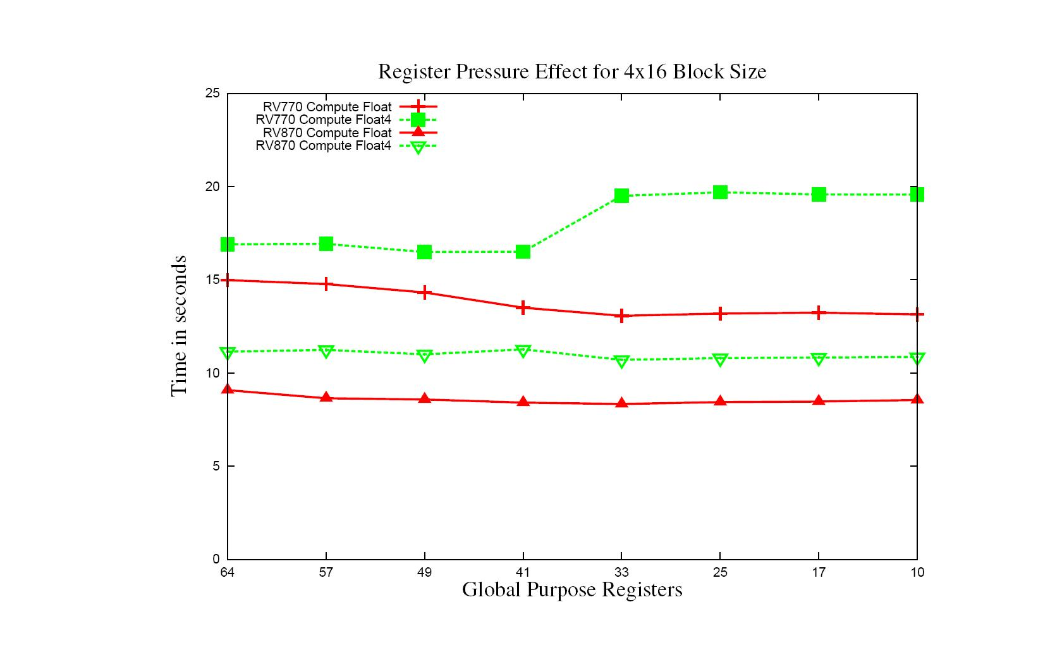
Register Usage – 4x16 Block Size
Cache Thrashing

Slide 71
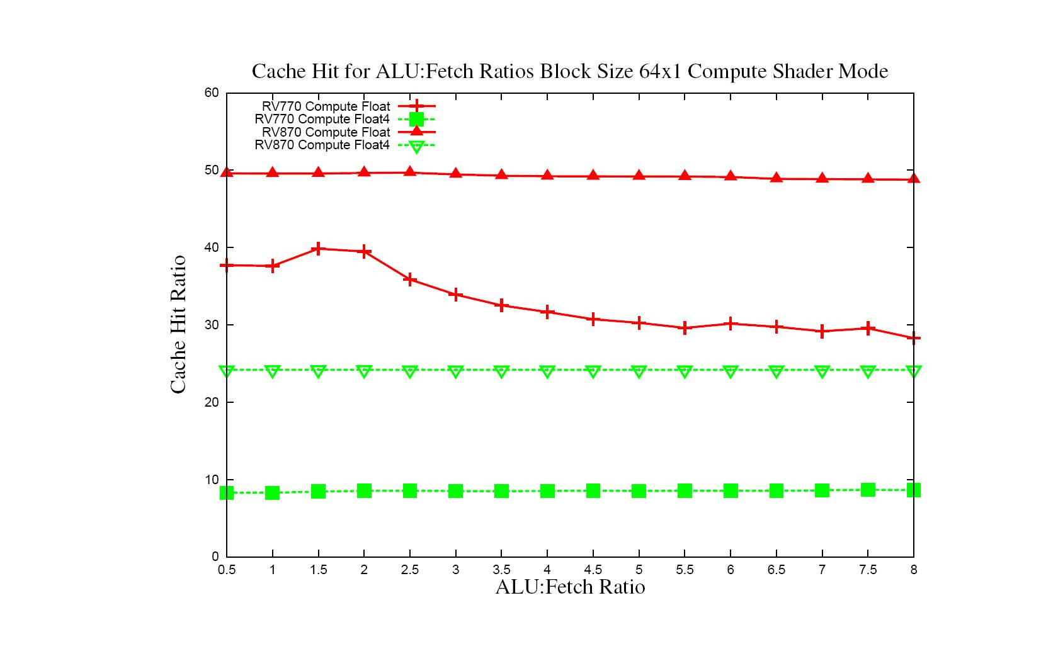
Cache Use – ALU:Fetch 64x1
Slight impact in performance

Slide 72
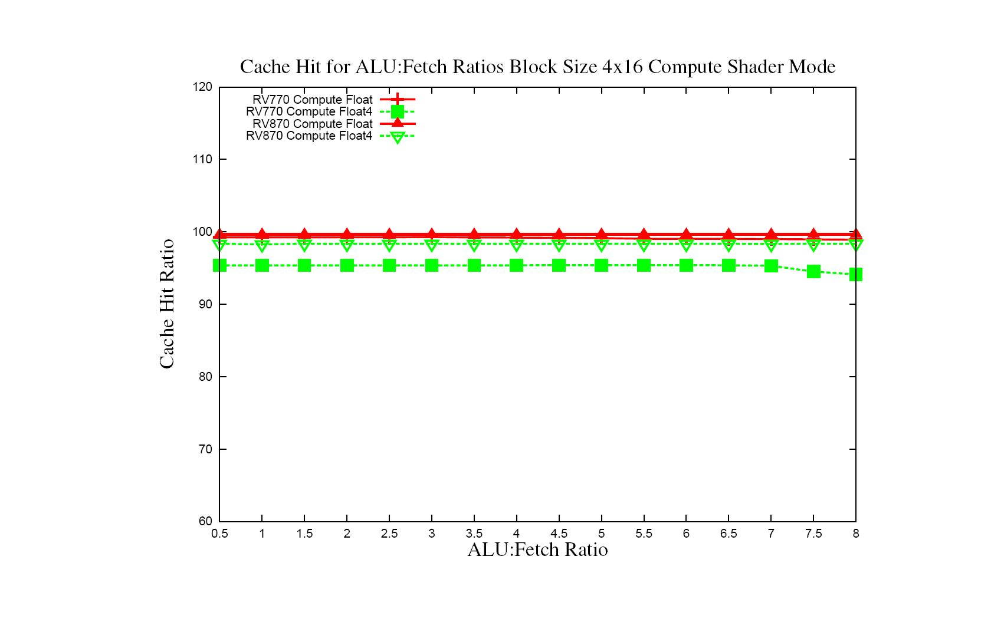
Cache Use – ALU:Fetch 4x16
Cache Hit Ratio not effected much by number of ALU operations

Slide 73
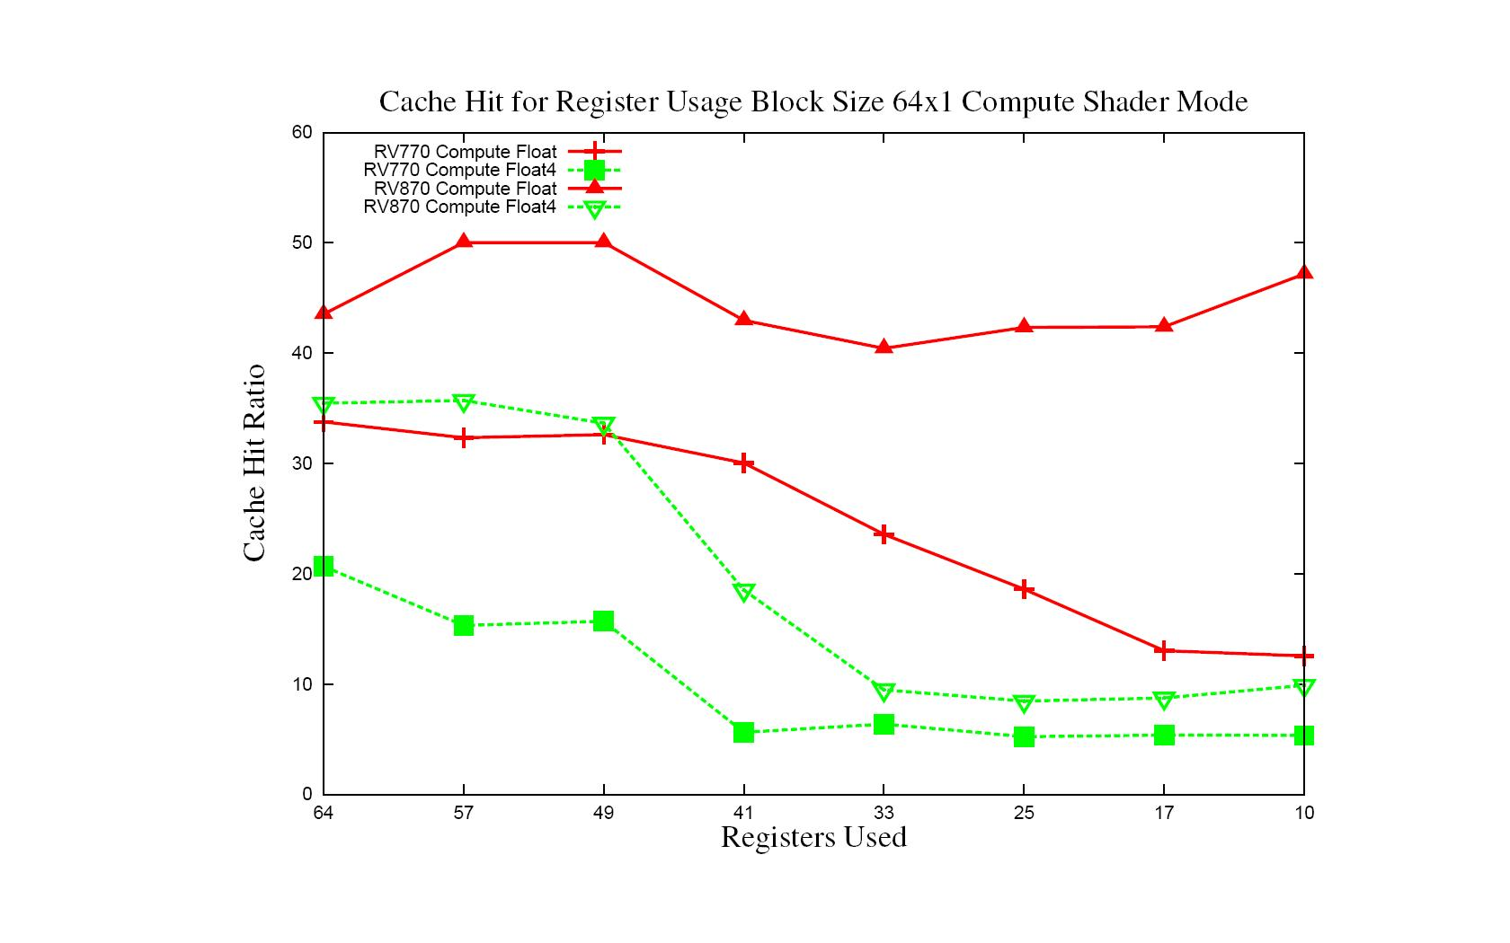
Cache Use – Register Usage 64x1
Too many wavefronts

Slide 74
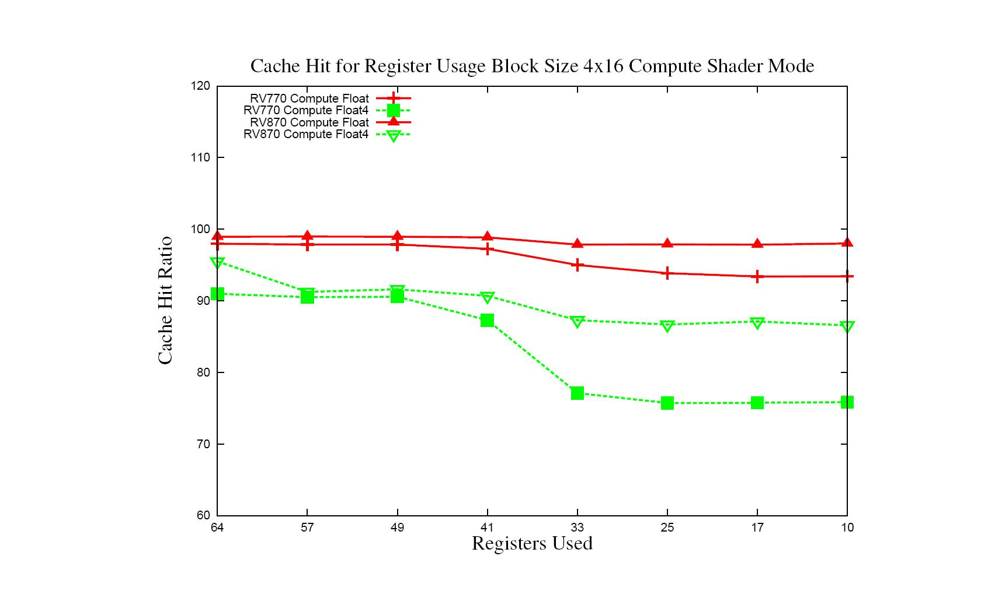
Cache Use – Register Usage 4x16
Cache Thrashing

Slide 75
Conclusion/Future Work
Conclusion
  Attempt to understand behavior based on program characteristics, not specific algorithm
    Gives guidelines for more general optimizations
  Look at major kernel characteristics
    Some features maybe driver/compiler limited and not necessarily hardware limited
      Can vary somewhat among versions from driver to driver or compiler to compiler
Future Work
  More details such as Local Data Store, Block Size and Wavefronts effects
  Analyze more configurations
  Build predictable micro-benchmarks for higher level language (ex. OpenCL)
  Continue to update behavior with current drivers

