Slide 1
Topic 3 – II
Program Execution Model vs. OS Model –
Fine-Grain Case Studies
Guang R. Gao
ACM Fellow and IEEE Fellow
Endowed Distinguished Professor
Electrical & Computer Engineering
University of Delaware
ggao@capsl.udel.edu

Slide 2
Outline
Introduction: Multit-Core Era
The Role of Traditional OS
The New Era: Challenges and Opportunities
Go Beyond the Traditional OS Shadow – Exploitation of Parallel Execution Models
Case Studies
Remarks on Related Work
Summary

Slide 3
Power4 (2001)
1.1 to 1.3 GHz
(1)(2)(2)
Power5 (2004)
1.5-1.9 GHz
(1)(2)(4)
Xenon (2005)
3.2 GHz
(1)(3)(6)
CBE (2006)
3.2 GHz
(1)(9)(10)
Power6
3.5-4.7 GHz
(1)(2)(4)
Power6+
5 GHz
(1)(2)(4)
Ultra SPARC IV
1-1.356 GHz
(1)(2)(2)
Pentium D
3.8 GHz
(1)(2)(4)
Core 2
1.8-3.2 GHz
(1)(4)(8)
Opteron Denmark
1.6-2.8GHz
(1)(2)(2)
Dual Core Atom
0.8-2.06 GHz
(1)(2)(2)
Sandy Bridge
4.6 GHz
(1)(8)(8)
Ultra SPARC T2
1-1.66 GHz
(1)(8)(64)
Opteron Istanbul
2.26-2.66GHz
(1)(6)(6)
Opteron Interlagos
???
(1)(16)(16)
Ultra SPARC VIIIfx
2.4-2.56 GHz
(1)(8)(16)
2001
2002
2003
2004
2005
2006
2007
2008
2009
2010
2011
M
S
M
S
M
S
M
S
M
S
M
S
M
S
M
S
M
S
M
S
O
N
O
N
O
N
O
N
O
N
O
N
O
N
O
N
O
N
O
J
N
F
M
A
J
J
A
D
J
F
M
A
J
J
A
D
J
F
M
A
J
J
A
D
J
F
M
A
J
J
A
D
J
F
M
A
J
J
A
D
J
F
M
A
J
J
A
D
J
F
M
A
J
J
A
D
J
F
M
A
J
J
A
D
J
F
M
A
J
J
A
D
J
F
M
A
J
J
A
D
IBM
SUN / ORACLE
AMD
Ultra SPARC IV+
1.5-2.16 GHz
(1)(2)(2)
Ultra SPARC T1
1-1.46 GHz
(1)(4)(32)
Ultra SPARC VII
2.4-2.56 GHz
(1)(4)(16)
Opteron Sao Paolo
???
(1)(6)(6)
Opteron Magny Cours
???
(1)(12)(12)
INTEL
Xeon
2.86–3.56 GHz
(1)(2)(2)
Xeon Quad Code
2.13–3.56 GHz
(1)(4)(8)
Opteron Barcelona
1.76-2.6GHz
(1)(4)(4)
Core 7i
2.66–3.33 GHz
(1)(4)(8)
Xeon Beckton
2.8–3.56 GHz
(1)(8)(16)
Name
Hertz
(Processor)(Cores)(Threads)
Power4+ (2003)
1.9 GHz
(1)(2)(2)
Power5+ (2005)
1.5-2.26 GHz
(1)(2)(4)
PowerXCell8i (2008)
3.2GHz
(1)(9)(10)
Power6+
5 GHz
(1)(2)(4)

Slide 4
Architecture Features and Trends
Feature/Trend I: The core is becoming simpler and simpler
Feature/Trend II: The number of cores is becoming larger and larger
Feature/Trend III: The on-chip memory per core is becoming smaller and smaller
Others

Slide 5
Outline
Introduction: Multit-Core Era
The Role of Traditional OS
The New Era: Challenges and Opportunities
Go Beyond the Traditional OS Shadow – Exploitation of Parallel Execution Models
Case Studies
Remarks on Related Work
Summary

Slide 6
What is OS Anyway ?
The operating system acts as a host for computing applications run on the machine. As a host, one of the purposes of an operating system is to handle the details of the operation of the hardware. This relieves application programs from having to manage these details and makes it easier to write applications.
        [From Wikipedia]

Slide 7
What is OS Anyway ? (cont’d)
  Operating systems offer a number of services to application programs and users. Applications access these services through application programming interfaces (APIs) or system calls. By invoking these interfaces, the application can request a service from the operating system, pass parameters, and receive the results of the operation.
  [From Wikipedia]

Slide 8
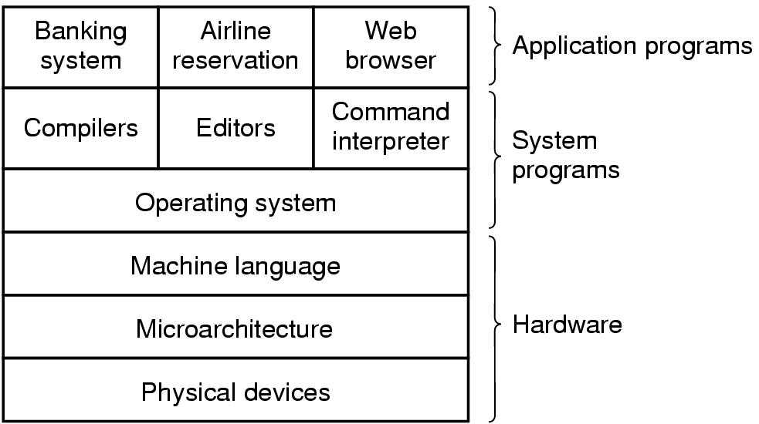
Operating System
A computer system consists of
  hardware
  system programs
  application programs
A Tanenbaum: Modern
Operating Systems,
second ed., 2002]

Slide 9
Abstract View of the Components of a computer system
User
1
User
2
User
3
User
n
compiler
assembler
Text
editor
Database
system
Application Programming
Operating System
[Patterson &
Silberrschatz ]
Computer
Hardware

Slide 10
Two Basic Functions of Modern OS
Function 1: Extending the Machine (or virtual machine)
Purpose: Make the machine easier to program (e.g. through system calls)
Function 2: Managing the Resources
Purpose: Provide an orderly and controlled allocation of resources to various programs competing for them.
Tanenbaum: Modern Operating Systems,
second ed., 2002]

Slide 11
Traditional OS Functions
Which services / functions a traditional OS has ?
Process Management & Services (e.g. CPU Scheduling)
Register allocation
Memory Management & Services (e.g. Virtual Memory)
Instruction Scheduling
I/O Management & Services (e.g. Device Drivers)
Branch Prediction
Protection & Security Services
Which services / functions do not belong to traditional OS ?
Control Speculation
File Systems

Slide 12
Operating System Services
Process management/services
  CPU scheduling
Memory management/services
  Virtual memory
I/O management/services
  Device drivers
File Systems
Protection/security services

Slide 13
Functions Do Not Belong To A Classical OS?
In sequential processors/cores, the OS does not do (or interfere with)
  Instruction scheduling
  Register allocation
  Branch prediction
  Control speculation
  Etc …
But Why ?

Slide 14
How About OS in
Many-Core Era ?

Slide 15
Outline
Introduction: Multi-Core Era
The Role of Traditional OS
The New Era: Challenges and Opportunities
Go Beyond the Traditional OS Shadow – Exploitation of Parallel Execution Models
Case Studies
Remarks on Related Work
Summary

Slide 16
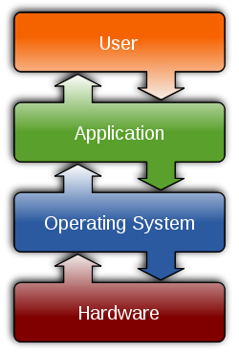
Conceptual Role of OS – Revist ?

Slide 17
Questions ?
Should OS directly manage user threads ?
Should OS directly manage inter-thread synchronization/communication ?
Should OS dictates shared memory semantics of a multi-thread programs ? (consistency model, etc.)
Should OS …

Slide 18
Terminology Clarification
Parallel Model of Computation
  Parallel Models for Algorithm Designers
  Parallel Models for System Designers
    Parallel Programming Models
    Parallel Execution Models
    Parallel Architecture Models
I
18
Notes:
18

Slide 19
What Does Program Execution Model (PXM) Mean ?
19
In the context of this talk,
The program execution model (PXM) is the basic abstraction of the underlying system architecture upon which our programming model, compilation strategy, runtime system, and other software components are developed. The PXM (and its API) serves as an interface between the architecture and the software.
Notes:
19

Slide 20
Overall Statements
A challenge with current parallel compuing systems is that they are developed based on sequential models of computation that cannot utilize parallelism. An execution model is needed that enables the programmer to perceive the system as a unified and naturally parallel computer system.

Slide 21
Outline
Introduction: Multi-Core Era
The Role of Traditional OS
The New Era: Challenges and Opportunities
Go Beyond the Traditional OS Shadow – Exploitation of Parallel Execution Models
Case Studies
Remarks on Related Work
Summary

Slide 22
What is A Shared Memory Execution Model?
Thread Model
A set of rules for creating, destroying and managing threads
Execution
Model
Memory Model
Dictate the ordering of memory operations
Synchronization Model
Provide a set of mechanisms to protect from data races
The Thread Virtual Machine
22
Notes:
22

Slide 23
Case Studies of PXM for Parallel Computing Systems
Dataflow Model (1970s - )
EARTH Model (1988 - )
HTVM Model (2000 - )

Slide 24
CASE I:
The Dataflow Execution Model

Slide 25
Dataflow Model of Computation
a
b
c
d
e
1
+
3
4
*
+
3
France-Summer-2008-Subject-II
25

Slide 26
Dataflow Model of Computation
a
b
c
d
e
+
4
4
*
+
3
France-Summer-2008-Subject-II
26

Slide 27
Dataflow Model of Computation
a
b
c
d
e
+
4
*
7
+
France-Summer-2008-Subject-II
27

Slide 28
Dataflow Model of Computation
a
b
c
d
e
+
28
*
+
France-Summer-2008-Subject-II
28

Slide 29
Dataflow Model of Computation
a
b
c
d
e
1
+
3
28
4
*
+
3
Dataflow Software Pipelining
[Gao 1986,1990]
France-Summer-2008-Subject-II
29

Slide 30
Questions on Dataflow Models
What is the Thread Model ?
What is the Synchronization Model ?
What is the Memory Model ?

Slide 31
CASE II:
The EARTH Execution Model
(1988 - )

Slide 32
Von Neumann Threads as Macro Dataflow Nodes
A sequence of instructions is “packed” into a macro-dataflow node
1
2
3
Synchronization is done at the macro-node level
k
France-Summer-2008-Subject-II
32
Notes:
32

Slide 33
Hybrid Von Neumann/Dataflow
Execution/Architecture Models
Group a “sequence” of dataflow instruction into a “thread” or a macro dataflow node.
Data-driven synchronization among threads.
“Von Neumann style sequencing” within a thread.
Advantage:
Preserves the parallelism among threads but avoids unnecessary fine-grain synchronization between instructions within a sequential thread.
France-Summer-2008-Subject-II
33
Notes:
33

Slide 34
The EARTH Model
[Gao’s team: 1998 - ]
Two Level of Fine-Grain Threads:
- threaded procedures
- fibers
fiber within a frame
Aync. function invocation
A sync operation
Invoke a threaded func
2
2
1
2
Fibers
Signal
Token
0
1
0
2
2
4

Slide 35
i = 1
i = 2
i = 3
i = N
S1:
S2:
Sk:
T₁
T₂
T₃
T_{N}
For i = 1, i + 1, i <= N,
begin
S1: ,,,
S2: X[i] =
S3: Y[i] = … + x[i-1],,,
.
.
Sk: …
end
Note:
How the loop-carried dependences are handled.
Its implication to cross-core software pipelining.
A Loop Example

Slide 36
Questions on EARTH Model
What is the Thread Model ?
What is the Synchronization Model ?
What is the Memory Model ?

Slide 37
CASE III:
The HTVM Execution Model
(1999 - )

Slide 38
The HTVM Model – an Evolution From EARTH
[Gao, et. al: 2000-2008]
Global Shared Memory Address Space
Large-Grain Thread (LGT) - TNT
Small-Grain Thread (SGT)
Tiny-Grain Thread (TGT)
Invoke an SGT/Sync a TGT within same SGT
SYNC ops
Data-SYNC ops
Inter-LGT Communication & Synchronization
Note: the lower two levels of the
two threads are fine-grain
In the above execution scenario: three large grain threads are in progress, within each a number
of small grain threads are forked, where each invokes the execution of a collection of tiny grain
threads.

Slide 39
Relation Between
OS and PXM

Slide 40

App 1
Organic Execution System
Organic Operating System
Runtime Control
Thread
Scheduler
Load Balancer
Thread
Migration
Percolation Manager
Parallel Architectures

Slide 41
App 1
App 2
App (n)
. . . . . . . . .
Organic Operating System
Organic Execution System
(1)
Organic Execution System
(2)
Organic Execution System
(n)
. . . . . .
Parallel Architectures

Slide 42
App 1
App 2
App (n)
. . . . . . .
Organic Operating System
Organic Execution System (1)
Self-Aware
Monitoring & Control
Self-Aware
Runtime Control
Organic Execution System
(2)
Organic Execution System
(3)
Organic Execution System
(n)
. . . . . .
Scheduler
Memory Manager
Thread
Scheduler
Thread
Scheduler
Load Balancer
Load Balancer
File System
Device Drivers
Thread
Migration
Percolation Manager
Percolation Manager
Parallel Architectures

Slide 43
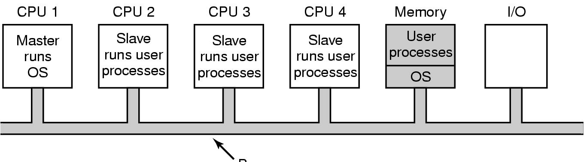
Multiprocessor OS
Bus
Master-Slave multiprocessors
(curtesy of Tanenbaum Text)

Slide 44
The Role of PXM vs OS
[July, 1999, Gao, 1999]
Applications
High-level
languages
e.g. parallel C
etc.
Note:
The threaded-C compiler has part of its functions embedded in RTS
The RTS will work with architecture and OS layers to provide the PXM interface
The performance models Are defined across all layers
High-level language
compiler
Threaded-C
Threaded-C
Compiler
and Tool Set
Performance Models
PXM
Interface
RTS
OS
Hardware Architectures
Threaded-C
Compiler
- RTS interface
RTS-OS interface
RTS-hardware
architecture
interface

Slide 45

Program/Execution Knowledge Database
Different Code Versions Generated by the Compiler
Domain Experts’ Knowledge
……
Runtime
Algorithms
Runtime Collected Information
HTVM
Applications
HTVM System Software/Tools
HTVM Compilation Technology
Static Compiler
Dynamic Compiler
Domain-Specific Knowledge & Scripts
Latency Adaptation
Locality Adaptation
Dynamic Load
Adaptation
Loop Parallelism
Adaptation
Feedback Loop
Selected Ultra-scale Scientific Applications
HTVM
Thread Model
(LGTs, SGTs, TGTs)
HTVM
Memory Model
HTVM
Synchronization
Model
Runtime Monitoring
HTVM Runtime System Software
HTVM Simulation Testbed )

Slide 46
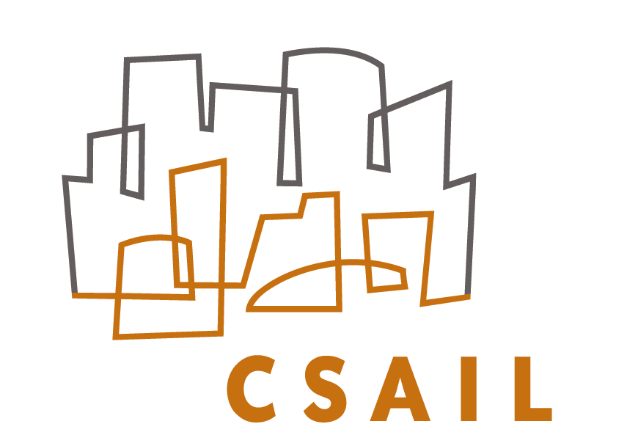


Programming Models and Storage System for High Performance Computation
(NSF Grant: 09/01/2009 - )
Jack Dennis
MIT CSAIL
Guang R Gao
University of Delaware
Vivek Sarkar
Rice University

Slide 47
(MIT)
(RICE)
(UDEL)
Declarative Programming Language
Strongly-Typed Imperative Language
Weakly-Typed Runtime Interface
Compiler
Compiler
Compiler
Dataflow IR
IR
Threaded IR
Intermediate Representation Transformations
Common Transformed IR
Code Generation
Multithreaded Execution Model (TNT-X) with
Storage System Runtime Library
Storage System

Slide 48
Outline
Introduction: Multi-Core Era
The Role of Traditional OS
The New Era: Challenges and Opportunities
Go Beyond the Traditional OS Shadow – Exploitation of Parallel Execution Models
Case Studies
Remarks on Related Work
Summary

Slide 49
Remarks on Dataflow Models
A fundamentally sound and simple parallel model of computation (very few other parallel models can claim)
Few dataflow architecture projects survived passing early 1990s.
In the new multi-core age: we have many reasons to re-examine and explore the original dataflow models and learn from the past

Slide 50
Roots
Asynchronous Digital Logic: Muller, Bartky
Control Structures for Parallel Programming: Conway, McIlroy, Dijkstra
Abstract Models for Concurrent Systems: Petri, Holt.
Theory of Program Schemes: Ianov, Paterson
Structured Programming: Dijkstra, Hoare
Functional Programming: McCarthy, Landin
Curtsey J.B. Dennis

Slide 51
Early Dataflow Work
1968: Dennis: “Programming Generality, Parallelism and Computer Architecture”
1967: Jorge Rodriguez. “A Graph Model for Parallel Computations”
1972: Dennis, Fosseen, Linderman: “Data Flow Schemas”
1974: Dennis, Misunas: “A Data Flow Processor for Signal Processing”
1975: Dennis, Misunas: “Preliminary Architecture for a basic Data Flow Processor”

Slide 52
Evolution of Multithreaded
Execution and Architecture Models
CHoPP’77
CHoPP’87
Non-dataflow
based
MASA
Halstead
1986
Alwife
Agarwal
1989-96
HEP
B. Smith
1978
Tera
B. Smith
1990-
Eldorado
CDC 6600
1964
CASCADE
Flynn’s
Processor
1969
Cosmic Cube
Seiltz
1985
J-Machine
Dally
1988-93
M-Machine
Dally
1994-98
Others: Multiscalar (1994), SMT (1995), etc.
Dataflow
model inspired
Monsoon
Papadopoulos
& Culler
1988
P-RISC
Nikhil &
Arvind
1989
*T/Start-NG
MIT/Motorola
1991-
MIT TTDA
Arvind
1980
LAU
Syre
1976
TAM
Culler
1990
Cilk
Leiserson
Iannuci’s
1988-92
Manchester
Gurd & Watson
1982
SIGMA-I
Shimada
1988
EM-5/4/X
RWC-1
1992-97
Static
Dataflow
Dennis 1972
MIT
Arg-Fetching
Dataflow
DennisGao
1987-88
MDFA
Gao
1989-93
MTA
HumTheobald
Gao 94
EARTH CARE
PACT95’,
ISCA96,
Theobald99
Marquez04
France-Summer-2008-Subject-II
52
Notes:
52

Slide 53
Summary and Future Work
Multi-Core era – a new page for parallel computing
Traditional OS and challenges
Break the shadow of OS noise: exploit parallelism with execution models
Case Studies
Remark
Future Work

Slide 54
… …
FFT
Compiler
Cook book
MM
In-place Stencil
Adjust compiler opts.
Run & profiling
Look up
Performance
analyzer
Profile analyzing
Out-place Stencil
Future Research: A Compilation Model for Self-Aware Systems
(Curtesy of H.M.Cui)

Slide 55
Acknowledgements
Our Sponsors
Members of CAPSL
Other Collaborators
My Host

