Slide 1
Dataflow Models

Slide 2
A Base-Language
~ Data Flow Graphs ~
To serve as an intermediate-level language for high-level languages
To serve as a machine language for parallel machines
- J.B. Dennis

Slide 3
Operational Semantics (Firing Rule)
Values represented by tokens
Placing tokens on the arcs
(assignment)
- snapshot/configuration: state
Computation
configuration configuration

Slide 4
Jac
MIT -1964
IBM announces System 360.
Project Mac selects GE 645 for Multics.
I decide to pursue research on relation of
program structure to computer architecture.
“Machine Structures Group formed.”
By Jack B. Dennis
11/9/2010
keynote-Italy-HPC-2010
4

Slide 5
Karp, Miller Parallel Program Schema
11/9/2010
keynote-Italy-HPC-2010
5

Slide 6
Data Flow Years at MIT
1974 – 1975
􀂃April 1974: Symposium on Programming, Paris. Dennis: “First
Version of a Data Flow Procedure Language”.
􀂃January 1975: Second Annual Symposium on Computer
Architecture, Houston. Dennis and Misunas: “A Preliminary
Architecture for a Basic Data-Flow Processor”.
􀂃August 1975: 1975 Sagamore Computer Conference on
Parallel Processing:
􀀹Rumbaugh: “Data Flow Languages”
􀀹Rumbaugh: “A Data Flow Multiprocessor”
􀀹Dennis: “Packet Commincation Architecture”
􀀹Misunas: “Structure Processing in a Data-Flow Computer”
.
11/9/2010

Slide 7
Operation units
Update
unit
queue
Fetch
unit
Activity
store
+
a
b
*
Z = (a + b) * (c - d)
z
-
Gao and Theobald: The Static
Dataflow Enable Memory Chip
(fall, 1984)
c
d
MIT Static Dataflow Processor Architecture
11/9/2010
keynote-Italy-HPC-2010
7

Slide 8
Early Roots on Dataflow Work
at MIT in 70s
􀂃 Asynchronous Digital Logic [Muller, Bartky]
􀂃 Control Structures for Parallel Programming:
[Conway, McIlroy, Dijkstra]
􀂃 Abstract Models for Concurrent Systems:
[Petri, Holt]
􀂃 Theory of Program Schemes [Ianov, Paterson]
􀂃 Structured Programming [Dijkstra, Hoare]
􀂃 Functional Programming [McCarthy, Landin]
11/9/2010

Slide 9
Symposium on Theoretical Programming
Novosibirsk 1972
11/9/2010
keynote-Italy-HPC-2010
9

Slide 10
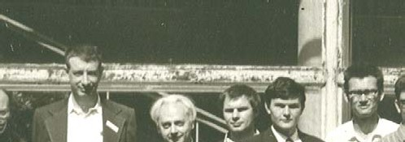
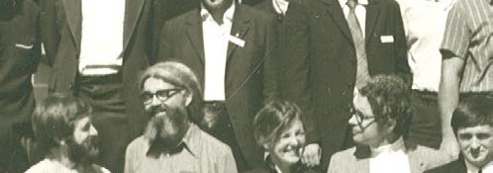
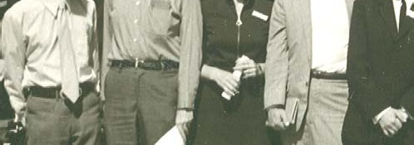
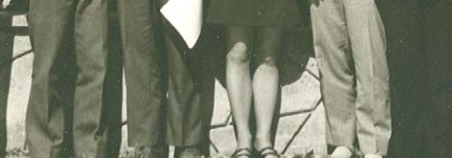
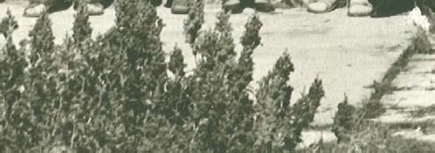
Notables Novosibirsk -1972
J. Schwartz
Bahrs
Luckham
M. Engeler
Ershov
Milner
McCarthy
Warren
Paterson
Miller
Igarashi
Hoare
F. Allen
Dennis
11/9/2010
keynote-Italy-HPC-2010
10

Slide 11
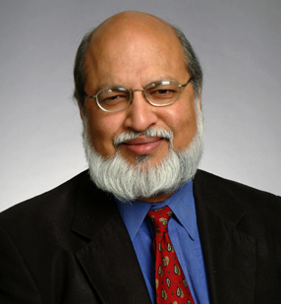
Dataflow Work at MIT in 1980s led by Arvind and his group (Nikhil, etc.)
Arvind
Nikhil
UC Irvine; U-Interpreter; Preliminary Id Report
Joined MIT (Dennis’ CSG group)
1978
Organized FPCA conference, Portsmouth NH
1981
Attended FPCA conference, Portsmouth NH
Arvind forms “FLA” group (Functional Languages
and Architectures) for dynamic dataflow work
PhD work on using functional languages for
database query
1984
Joined MIT, FLA group in LCS
Collaborated on
Id, pH,
TTDA, Monsoon, P-RISC, early *T
Jack Dennis’ original CSG group shuts down
Arvind renames group to “CSG”
~1989
1991
Left MIT
Continued collaboration on Id/pH
Created Sandburst
2000
Joined Sandburst
2003
11/9/2010
Co-founded Bluespec, Inc.
11

Slide 12
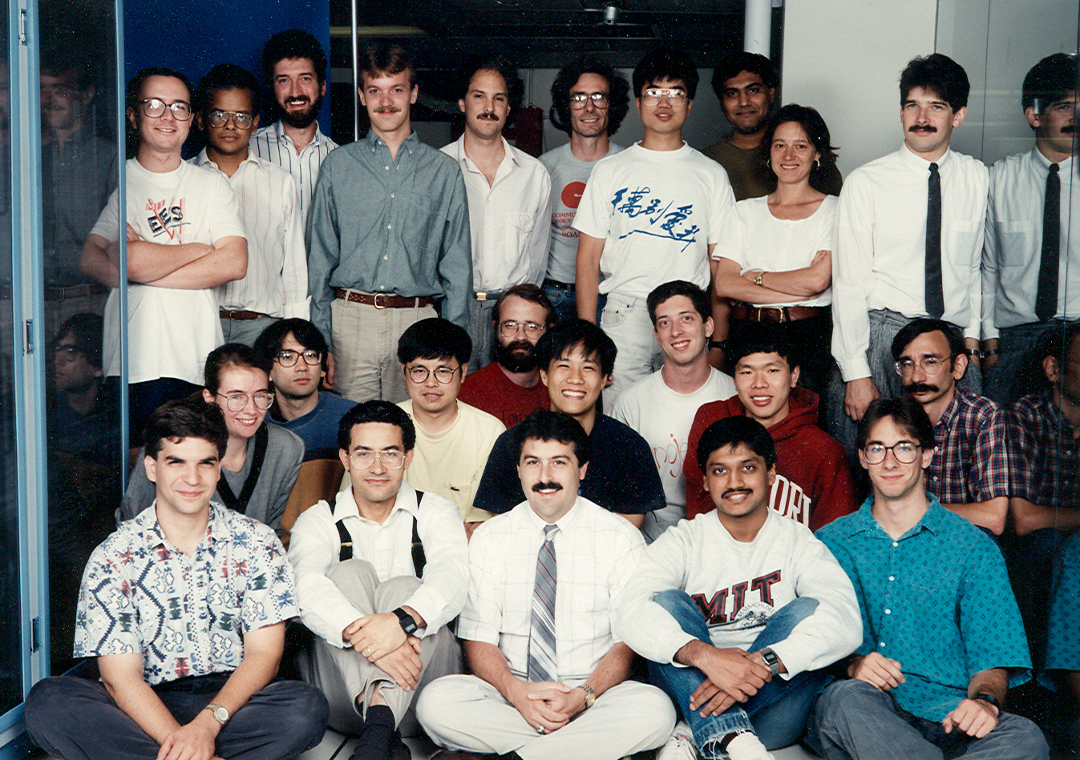
The Monsoon Project Motorola Cambridge Research Center + MIT
MIT-Motorola collaboration 1988-91
Research Prototypes
Monsoon
Processor
64-bit
16-node
Fat Tree
I-structure
100 MB/sec
10M tokens/sec
Unix Box
4M 64-bit words
16 2-node systems (MIT, LANL, Motorola,
Colorado, Oregon, McGill, USC, ...)
2 16-node systems (MIT, LANL)
Id World Software
Tony Dahbura

Slide 13
Dataflow Graphs
x = a + b;
z = b * 7;
z = (x-y) * (x+y);
a
b
7
1
2
Values in dataflow graphs are represented as tokens of the form:
x
y
<ip, p, v>
<3, Left, value>
3
4
Where ip is the instruction pointer p is the port and v represents the data
5
An operator executes when all its input tokens are present; copies of the result token are distributed to the destination operators.
No separate control flow

Slide 14
Dataflow Operators
A small set of dataflow operators can be used to define a general programming language
Fork
Primitive Ops
Switch
Merge
+
T
T
T
F
T
F
⇒
+
T
T
T
F
T
F

Slide 15
Well-behaved Data Flow Graphs
Data flow graphs that produce exactly one set of result values at each output arcs for each set of values presented at the input arcs
Implies the initial configuration is re-established
Also implies determinacy

Slide 16
Properties of Well-Behaved Dataflow Schemata
v₁
v_{m}
.....
.....
1
m
1
m
An (m, n) Scheman
with no enabled actors
An (m, n) Scheman
with no enabled actors
.....
.....
1
n
1
n
(a) Initial Snapshot
(a) Final Snapshot

Slide 17
Well Behaved Schemas
• • •
• • •
one-in-one-out
& self cleaning
P
P
• • •
• • •
Before
After
Conditional
Loop
T
F
F
T
F
p
f
g
T
F
T
F
f

Slide 18
Well-formed Dataflow Schema (Dennis & Fossen 1973)
An operator is a WFDS
A conditional schema is a WFDS
A iterative (loop) schema is a WFDS
An acyclic composition of component WFDS is a WFDS

Slide 19
Theorem
“A well-formed data flow graph is well-behaved”
proof by induction

Slide 20
Operation units
Update
unit
queue
Fetch
unit
Activity
store
+
a
b
*
Z = (a + b) * (c - d)
z
-
c
d
A Static Dataflow Processor Architecture

Slide 21
The Monsoon Processor Arvind, Nikhil, Papadouplous, Culler, etc
op
r
d1,d2
Instruction Fetch
ip
Code
fp+r
Operand Fetch
Token
Queue
Frames
ALU
Form Token
Network
Network

Slide 22
Example of “Sick” Dataflow Graphs
Arbitrary connections of data flow operators can result in pathological programs, such as the following:
A
J
B
D
E
G
H
K
L
M
N
C
A
I
1. Deadlock 2. Hangup 3. Conflict 4. Unclean

Slide 23
Well-behaved Program
Always determinate in the sense that a unique set of output values is determined by a set of input values
References:
Rodriquez, J.E. 1966, “A Graph Model of Parallel Computation”,
MIT, TR-64]
Patil, S. “Closure Properties of Interconnections of Determinate
Systems”, Records of the project MAC conf. on concurrent systems
and parallel Computation, ACM, 1970, pp 107-116]
Denning, P.J. “On the Determinacy of Schemata” pp 143-147
Karp, R.M. & Miller, R.E., “Properties of a Model of Parallel
Computation Termination, termination, queuing”, Appl. Math, 14(6), Nov. 1966

Slide 24
Remarks on Dataflow Models
A fundamentally sound and simple parallel model of computation (features very few other parallel models can claim)
Few dataflow architecture projects survived passing early 1990s. But the ideas and models live on ..
In the new multi-core age: we have many reasons to re-examine and explore the original dataflow models and learn from the past

