Slide 1
Topic A Dataflow Model of Computation
CPEG 852 - Spring 2014
Advanced Topics in Computing Systems

Slide 2
Outline
Parallel Program Execution Models
Dataflow Models of Computation
Dataflow Graphs and Properties
Three Dataflow Models
Static
Recursive Program Graph
Dynamic
Dataflow Architectures

Slide 3
Terminology Clarification
Parallel Model of Computation
Parallel Models for Algorithm Designers
Parallel Models for System Designers
Parallel Programming Models
Parallel Execution Models
Parallel Architecture Models

Slide 4
What is a Program Execution Model?
Application Code
Software Packages
Program Libraries
Compilers
Utility Applications
User Code
PXM
(API)
Hardware
Runtime Code
Operating System
System

Slide 5
Features a User Program Depends On
Features expressed within a Programming language
Procedures; call/return
Access to parameters and variables
Use of data structures (static and dynamic)
But that’s not all !!
File creation, naming and access
Object directories
Communication: networks and peripherals
Concurrency: coordination; scheduling
Features expressed Outside a (typical) programming language

Slide 6
Developments in the 1960s, 1970s
Highlights
1960
Other Events
Burroughs B5000 Project Started
Project MAC Funded at MIT
Rice University Computer
IBM announces System 360
Vienna Definition Method
Tasking introduced in Algol 68 and PL/I
Common Base Language, Dennis
1970
Burroughs builds Robert Barton’s DDM1
Contour Model, Johnston
Book on the B6700, Organick
Unravelling Interpreter, Arvind
1980
Graph / Heap Model, Dennis
RISC Architecture
Sigma 1 (1987)
IBM System 38
IBM AS / 400
Monsoon (1989)
1990
Distributed Systems
Personal Workstations
Internet
Drop in interest in Execution Models for 20+ Years

Slide 7
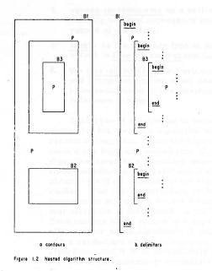
Contour Model: Algorithm; Nested Blocks and Contours
- Johnston, 1971

Slide 8
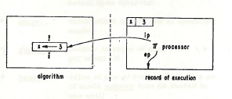
Contour Model: Processor
- Johnston, 1971

Slide 9
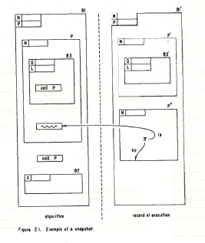
Contour Model: A Snapshot
- Johnston, 1971

Slide 10
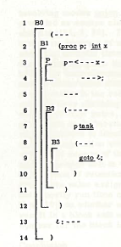
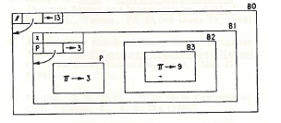
Two Processors Sharing Portions of Environment
- Berry, 1972
- Program with tasking
- Record of Execution

Slide 11
Idea: A Common Base Language
.
This is a report on the work of the Computation Structures Group of Project MAC toward the design of a common base language for programs and information structures. We envision that the meanings of programs expressed in practical source languages will be defined by rules of translation into the base language.
The meanings of programs in the base language is fixed by rules of interpretation which constitute a transition system called the interpreter for the base language.
We view the base language as the functional specification of a computer system in which emphasis is placed on programming generality -- the ability of users to build complex programs by combining independently written program modules.
- Dennis, 1972

Slide 12
What Does Program Execution Model (PXM) Mean ?
The notion of PXM
The program execution model (PXM) is the basic
low-level abstraction of the underlying system
architecture upon which our programming model,
compilation strategy, runtime system, and other software components are developed.
The PXM (and its API) serves as an interface between the architecture and the software.

Slide 13
Program Execution Model (PXM) Cont’d
Unlike an instruction set architecture (ISA) specification, which usually focuses on lower level details (such as instruction encoding and organization of registers for a specific processor), the PXM refers to machine organization at a higher level for a whole class of high-end machines as view by the users
Gao et al., 2000

Slide 14
What is your
“Favorite”
Program Execution Model?

Slide 15
Outline
Parallel Program Execution Models
Dataflow Models of Computation
Dataflow Graphs and Properties
Three Dataflow Models
Static
Recursive Program Graph
Dynamic
Dataflow Architectures

Slide 16
Dataflow Model of Computation
a
b
c
d
e
1
+
3
4
*
+
3

Slide 17
Dataflow Model of Computation
a
b
c
d
e
+
4
4
*
+
3

Slide 18
Dataflow Model of Computation
a
b
c
d
e
+
4
*
7
+

Slide 19
Dataflow Model of Computation
a
b
c
d
e
+
28
*
+

Slide 20
Dataflow Model of Computation
a
b
c
d
e
1
+
3
28
4
*
+
3
Dataflow Software Pipelining

Slide 21
A Base-Language
~ Data Flow Graphs ~
To serve as an intermediate-level language for high-level languages
To serve as a machine language for parallel machines
- J.B. Dennis

Slide 22

MIT -1964
IBM announces System 360.
Project Mac selects GE 645 for Multics.
I decide to pursue research on relation of
program structure to computer architecture.
“Machine Structures Group formed.”
By Jack B. Dennis

Slide 23

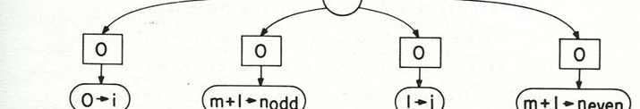
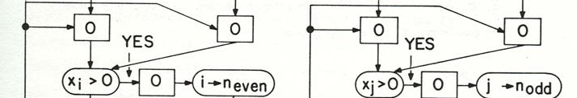
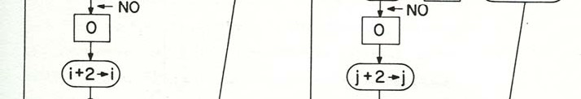
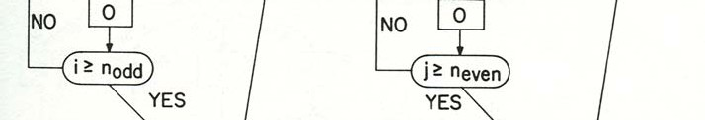
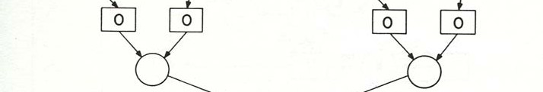

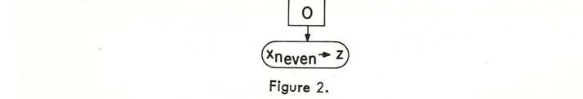
Karp, Miller Parallel Program Schema

Slide 24
Data Flow Years at MIT
1974 – 1975
April 1974: Symposium on Programming, Paris. Dennis:
First Version of a Data Flow Procedure Language.
January 1975: Second Annual Symposium on Computer Architecture, Houston. Dennis and Misunas:
A Preliminary Architecture for a Basic Data-Flow Processor.
August 1975: 1975 Sagamore Computer Conference on Parallel Processing:
Rumbaugh: Data Flow Languages.
Rumbaugh: A Data Flow Multiprocessor.
Dennis: Packet Communication Architecture.
Misunas: Structure Processing in a Data-Flow Computer.
.

Slide 25
Early Roots on Dataflow Work
at MIT in 70s
Asynchronous Digital Logic: [Muller, Bartky]
Control Structures for Parallel Programming: [Conway, McIlroy, Dijkstra]
Abstract Models for Concurrent Systems: [Petri, Holt]
Theory of Program Schemes: [Ianov, Paterson]
Structured Programming: [Dijkstra, Hoare]
Functional Programming: [McCarthy, Landin]
10/21/2014

Slide 26
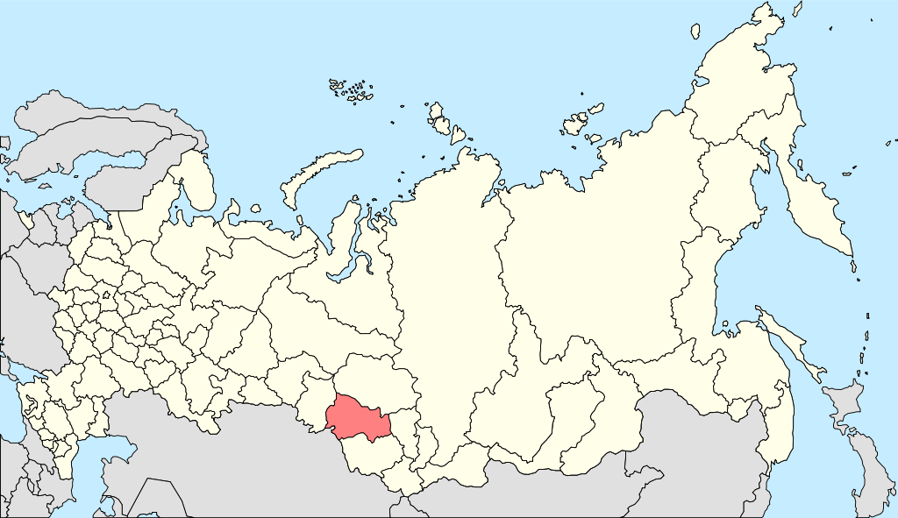
Novosibirsk

Slide 27
Symposium on Theoretical Programming
Novosibirsk 1972

Slide 28
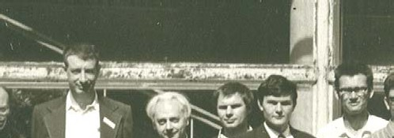
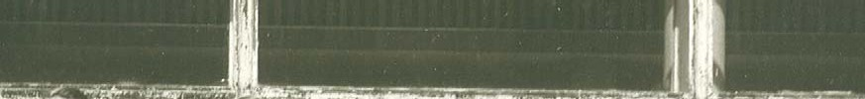
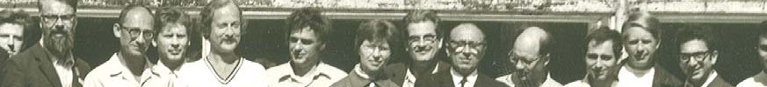
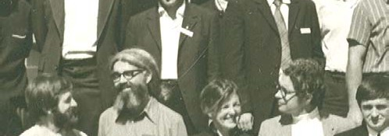
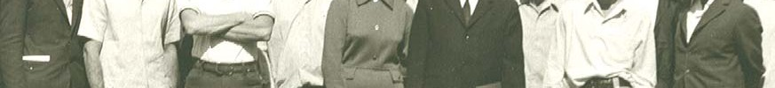
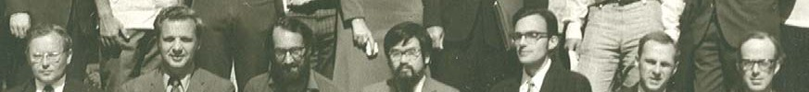
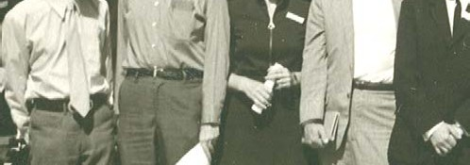
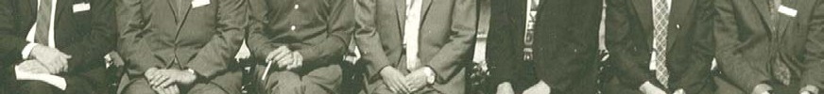
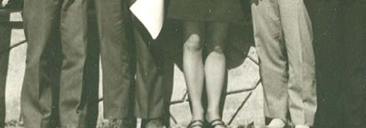
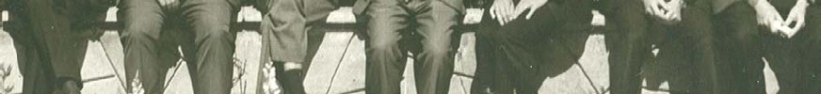

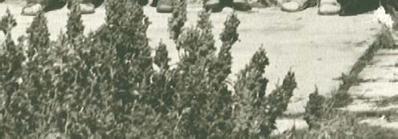

Notables Novosibirsk -1972
J. Schwartz
Bahrs
Luckham
M. Engeler
Ershov
Milner
McCarthy
Warren
Paterson
Miller
Igarashi
Hoare
F. Allen
Dennis

Slide 29
Outline
Parallel Program Execution Models
Dataflow Models of Computation
Dataflow Graphs and Properties
Three Dataflow Models
Static
Recursive Program Graph
Dynamic
Dataflow Architectures

Slide 30
Dataflow Operators
A small set of dataflow operators can be used to define a general programming language
Fork
Primitive Ops
Switch
Merge
+
T
T
T
F
T
F
⇒
+
T
T
T
F
T
F

Slide 31
Dataflow Graphs
x = a + b;
z = b * 7;
z = (x-y) * (x+y);
a
b
7
1
2
Values in dataflow graphs are represented as tokens of the form:
x
y
<s, d, v>
<3, Left, value>
3
4
Where s is the instruction pointer d is the port and v represents the data
5
An operator executes when all its input tokens are present; copies of the result token are distributed to the destination operators.
No separate control flow

Slide 32
Operational Semantics Firing Rule
Values represented by tokens
Placing tokens on the arcs
(assignment)
- snapshot/configuration: state
Computation
configuration configuration

Slide 33
Operational Semantics Firing Rule
Tokens ➔ Data
Assignment ➔ Placing a token in the output arc
Snapshot / configuration: state
Computation
The intermediate step between snapshots / configurations
An actor of a dataflow graph is enabled if there is a token on each of its input arcs

Slide 34
Operational Semantics Firing Rule
Any enabled actor may be fired to define the “next state” of the computation
An actor is fired by removing a token from each of its input arcs and placing tokens on each of its output arcs.
Computation ➔ A Sequence of Snapshots
Many possible sequences as long as firing rules are obeyed
Determinacy
“Locality of effect”

Slide 35
General Firing Rules
A switch actor is enabled if a token is available on its control input arc, as well as the corresponding data input arc.
The firing of a switch actor will remove the input tokens and deliver the input data value as an output token on the corresponding output arc.
A (unconditional) merge actor is enabled if there is a token available on any of its input arcs.
An enabled (unconditional) merge actor may be fired and will (non-deterministically) put one of the input tokens on the output arc.

Slide 36
Conditional Expression
x
y
if (p(y))
{
f(x,y);
}
else
{
g(y);
}
p
T
T
F
f
g

Slide 37
A Conditional Schema
m
k
D
(k,1)
T
F
m
m
P
(m,n)
Q
(m,n)
n
n
n

Slide 38
A Loop Schema
Initial Loop value
T
F
F
COND
T
F
Loop op

Slide 39
Properties of Well-Behaved Dataflow Schemata
v₁
v_{m}
.....
.....
1
m
1
m
An (m, n) Scheman
with no enabled actors
An (m, n) Scheman
with no enabled actors
.....
.....
1
n
1
n
(a) Initial Snapshot
(a) Final Snapshot

Slide 40
Well-behaved Data Flow Graphs
Data flow graphs that produce exactly one set of result values at each output arcs for each set of values presented at the input arcs.
Implies the initial configuration is re-established.
Also implies determinacy.
[Dennis and Van Horn 1966,
Dennis,et. Al. 1972/3/4]

Slide 41
Well Behaved Schemas
• • •
• • •
one-in-one-out
& self cleaning
P
P
• • •
• • •
Before
After
Conditional
Loop
T
F
F
T
F
p
f
g
T
F
T
F
f

Slide 42
Well-formed Dataflow Schema (Dennis & Fossen 1973)
An operator is a WFDS.
A conditional schema is a WFDS.
A iterative (loop) schema is a WFDS.
An acyclic composition of component WFDS is a WFDS.

Slide 43
Theorem
“A well-formed data flow graph is well-behaved”
proof by (structural) induction

Slide 44
Example of ‘Sick’ Dataflow Graphs
Arbitrary connections of data flow operators can result in pathological programs, such as the following:
A
J
B
D
E
G
H
K
L
M
N
C
A
I
1. Deadlock 2. Hang-up 3. Conflict 4. Unclean

Slide 45
Well-behaved Program
Always determinate in the sense that a unique set of output values is determined by a set of input values
References:
Rodriquez, J.E. 1966, “A Graph Model of Parallel Computation”,
MIT, TR-64]
Patil, S. “Closure Properties of Interconnections of Determinate
Systems”, Records of the project MAC conf. on concurrent systems
and parallel Computation, ACM, 1970, pp 107-116]
Denning, P.J. “On the Determinacy of Schemata” pp 143-147
Karp, R.M. & Miller, R.E., “Properties of a Model of Parallel
Computation Termination, termination, queuing”, Appl. Math, 14(6), Nov. 1966

Slide 46
Remarks on Dataflow Models
A fundamentally sound and simple parallel model of computation (features very few other parallel models can claim).
Few dataflow architecture projects survived passing early 1990s. But the ideas and models live on.
In the new multi-core age: we have many reasons to re-examine and explore the original dataflow models and learn from the past.
Eventually, after 40+ years, Jack Dennis’ dataflow model was recognized by the world – and awarded the IEEE John Von Neumann Medal (an ACM Turing Award equivalent – as some people say.)

Slide 47
Graph / Heap Model Of Program Execution
In our semantic model for extended data flow programs, values are represented by a heap, which is a finite, acyclic, directed graph having one or more root nodes, and such that each node of the heap may be reached over some path from some root node.
A snapshot of a data flow program in execution will now have two parts:
a token distribution on the graph of the program, and a heap.
For each execution step some enabled link or actor is selected to fire; the result of firing is a new token distribution,
and in some cases, a modified heap.
- Dennis, 1974

Slide 48
The Graph and Heap Model
Before:
5
Select
0 1 2 .. 5 ..
10
Select
Heap
After:
10

Slide 49
A Short Story on Dataflow
Jack B Dennis, Guang R Gao propose An efficient pipelined dataflow processor architecture in Proceedings of the 1988 ACM/IEEE conference on Supercomputing
Karp and Miller analyzed Computation Graphs w/o branches or merges
Dennis proposes a dataflow language. Pure Dataflow is born
Enea proposes a language design
for concurrent processes.
Arvind, et al. designed the Monsoon dataflow machine
1960
1970
1980
1990
2000
Carl Adam Petri defines Petri Nets
Rodriguez proposes Dataflow Graphs
Arvind and Gostelow, & separately Gurd and Watson created a tagged token dataflow model. Dynamic Dataflow is born
Estrin and Turn proposed an early dataflow model
Kahn proposes a simple parallel processing language with vertices as queues. Static Dataflow is born
Dennis designs a dataflow arch
Notes:
Petri’s paper is called “Fundamentals of a Theory of Asynchronous Information Flow“. Can’t find a digital copy
Dennis’s Dataflow Schemas is not actually available for free
Kahn link is a private website, may want to migrate to CAPSL server instead, if legal

Slide 50
Evolution of Multithreaded Execution and Architecture Models
CHoPP’77
CHoPP’87
Non-dataflow
based
MASA
Halstead
1986
Alwife
Agarwal
1989-96
HEP
B. Smith
1978
Tera
B. Smith
1990-
Eldorado
CDC 6600
1964
CASCADE
A version of this slide was presented
in my invited talk at Fran Allen’s
retirement party July 2002
Flynn’s
Processor
1969
Cosmic Cube
Seiltz
1985
J-Machine
Dally
1988-93
M-Machine
Dally
1994-98
Others: Multiscalar (1994), SMT (1995), etc.
Monsoon
Papadopoulos
& Culler
1988
P-RISC
Nikhil &
Arvind
1989
*T/Start-NG
MIT/Motorola
1991-
MIT TTDA
Arvind
1980
Dataflow
model inspired
Cilk
Leiserson
LAU
Syre
1976
Iannuci’s
1988-92
TAM
Culler
1990
Manchester
Gurd & Watson
1982
SIGMA-I
Shimada
1988
EM-5/4/X
RWC-1
1992-97
Static
Dataflow
Dennis 1972
MIT
HTVM/TNT-X
DelCuvillo
and Gao
2000-2010
Codelet
Model
Gao et. al.
2009-
Arg-Fetching
Dataflow
DennisGao
1987-88
MDFA
Gao
1989-93
EARTH
Hum et al.
1993-2006
Notes:
50

Slide 51
Jack’s History Note
Prof. Estrin was author of a number of paper relating to parallel graph models for computation.
The ones I recall were written with Prof. David W--- (?) who was a visiting scientist at MIT for a year or so (I don't recall what year).
The Dennis Static data flow model was implicit in the Dennis, Misunas 1975 paper for ISCA and was the subject of my lectures as IEEE Distinguished speaker, but I can't quickly determine the year. I presented a definitive paper at the "Symposium on Theoretical Programming", Novosibirsk, 1972, and it was published in LNCS. If I recall correctly it was CSG Memo 81, but a copy is not in my file. So I think the date (1972) for static data flow on the second slide is correct (and I believe precedes Kahn). So I think the box "Dennis proposes ... " is wrong (perhaps depending on what is meant by "pure dataflow").
My view is that my 1974 paper is the first treatment of a reasonably complete "dynamic" data flow model, including arbitrary recursion and tree-structured data objects (to be followed in two or three years by Arvin/Gostelow/Plouff).
Jack Dennis
Personal Communication
Sept. 11, 2011

Slide 52
Some Note on History

Slide 53
Some History on Dataflow

